Slide 1
Complete understanding of Exercise Science program
Courses
Professional Development hours/Internships
Careers
Rowan Support
Research
What it takes for graduate school
Exercise is Medicine club, Hootboard, Health Professions
Foundations course
Site visits
PDH
Interview
Research project
Notes:
I like to start each new PP with a review of what we have completed and what students should know.
This slide reviews that.
All students should have books and make sure they bring them to class
Anyone without a book, make sure you note it in your roll book

Slide 2
Hellen Keller
When asked is there anything worse than being blind. She responded…
“The only thing worse than being blind is having sight, but no vision.”
Notes:
Our first focus of the course is to help them develop a vision for their career
They need to know where they want to be so they can create a plan to get there
I like to use quotes to get them thinking (ask them what Helen Keller meant by this and how it applies to them
Helen Adams Keller was an American author, political activist, and lecturer. She was the first deaf-blind person to earn a bachelor of arts degree
1880-1968
**ASK STUDENTS WHERE THEY WANT TO BE AND THEIR PLAN TO GET THERE
GIVE THEM TIME TO THINK AND GO AROUND THE ROOM RANDOMLY ASKING STUDENTS THEIR PLAN

Slide 3
Creating a vision statement
“A statement that clearly communicates your GOALS and serves as a tool for specific strategic decision making that progresses you towards those goals”
Project five to 10 years in the future
Dream big and focus on success
Use the present tense
Use clear, concise language
Infuse your vision statement with passion and emotion
Paint a graphic mental picture of the career you want
Notes:
https://www.businessnewsdaily.com/3882-vision-statement.html
creating a vision statement is articulating your dreams and hopes for your career
vision statements answer the question, "Where do I want to go/be?“
Each student is going to create their own vision statement (assignment 2) so let’s teach them what a vision statement is and get them started on their own
Let them know their vision may change 10 times while at Rowan, but they need one to create the strategies to go where they want to go
Without a vision people just float through life bouncing from one thing to another.

Slide 4
Vision Statements
“Bring inspiration and innovation to every athlete in the world. (If you have a body, you are an athlete)” Nike
“To develop leaders who will one day make a global difference”. Harvard Univ.
“We will help people live longer, healthier, happier, lives” CVS
Creating a vision statement is articulating your dreams and hopes for your career
Vision statements answer the question… "Where do I want to go/be?"
Notes:
This course is about helping students to move in the direction of their career dreams and establishing what needs to happen to get there.
It begins the plan. If you do not know where you want to go, you cannot get there.
Students need to realize this will change throughout college and their life, but they need to start somewhere
Ask students what these companies vision statements say to them
Help them understand it is not about what their business sells, it is about the way they want things to be
Look at Nike: it does not say we want sell the best shoes or underarmor
Harvard does not say we want to graduate quality students
CVS does not say we sell the best cosmetics
Vision statements are BEYOND what students want to do for a career
When you ask students to write a vision statement they will say things like…
“I want to be a PT that helps kids get better” that is a career not a vision statement
This would be better “creating a world where all children are free from restrictions that interfere with their dreams”
In this, I don’t know how you are going to do it but I not what you want.

Slide 5
Rowan’s visionary Mission statement
Rowan University will become a new model for higher education by being inclusive, agile and responsive, offering diverse scholarly and creative educational experiences, pathways, environments, and services to meet the needs of all students
Notes:
Ask students what they think about the highlighted terms. Why did Rowan use those words, what does it say to its audience, what does it say to its employees
Make sure everyone provides feedback

Slide 6
Notes:
Students should know Rowan’s 4 pillars for ALL TESTS and EXAMS.
Tell them they will be tested on this
Access: to reach every person from every background not just in the state or country, but the world
Online, nights, weekends
Affordability: keeping the costs reasonable
Online, faculty writing books, Pro cents programs, support for loans and grants; creating better transfer systems, offering public school credits, RCGC, RCBC, CCCC
Quality: strong research
Economic engine: collaborating with businesses to drive the economy
CMSRU, SOM, entrepreneurial program

Slide 7
Vision and mission statements
Mission statement describes what a company wants to do now; a vision statement outlines what a company wants to be in the future
The Mission Statement concentrates on the present; it defines the customer, critical processes and it informs the employee about the desired level of performance.
Vision Statements focus on future, a source of inspiration & motivation
Describes not just future of the organization, but future of the industry or society in which the organization hopes to effect change
Notes:
Once a vision statement is created then next step is to create a mission statement

Slide 8
My Mission
“To prepare students to achieve their career goals by providing a dynamic and rigorous educational program that ensures the development of the knowledge, skills, experiences & disposition essential for success”
From Dr. Biren
Notes:
This is my mission statement: if you have one you may want to use yours (or create one if you do not have one)
Dynamic: all changing my classes; flipped classrooms, guest speakers, voice overs, etc.
Rigorous: if you don’t have to work for something you will not appreciate and you will not grow. No different than exercise; if you do not work out hard you will not gain
So every decision I make in the way I teach, grade, interact with students is ALWAYS based on my mission
If I have to make a tough decision, I go to my mission statement and ask will my decision be in alignment with my mission, if yes I do it, if no I don’t
e.g. if student’s do poorly on an exam do I curve (no because it takes away from rigor)
In a business, the mission statement must be clear to all employees (posted and reviewed) so they can stay on track with the way they are working

Slide 9
Values Statement
Describes what organizations believe in & how it will behave
Values create a moral compass for the company and employees
Allows for decision-making and establishes a standard that actions can be assessed against
Defines deeply held beliefs and principles of the organizational culture
These core values are an internalized framework that is shared and acted on by leadership
Notes:
Companies and students should have a values statement also
Have students create their values statement for being a student & then one for their career
All of this applies to everything in life, not just a career. They can apply it to their sports team, their family, etc.

Slide 10
My Values statement
Know each of my student’s passions for life & relate it to a career
Complete respect for students regardless of circumstances
Stay positive with ALL circumstances
Teach with passion and inspiration
NEVER, EVER quit on my students
Relate all content to “real life circumstances”; help students to understand how they will use all information I teach
Promote and learn diversity; help students to “be who they are”-Dr. Biren
Notes:
This is my values statement as a teacher
e.g. I work very hard to not just know all my students by name, but by their passion and what they want to do as a career
Ask students why I do that; how does that help me reach my vision?
You may want to create your own

Slide 11
Group work
Groups of 3 or 4 begin working on…
Create a vision statement
Create a mission statement
Create values statement
Notes:
This activity should take about 20 minutes
Once activity is over ask students to share and provide feedback this will take another 15 minutes
This is assignment 2

Slide 12
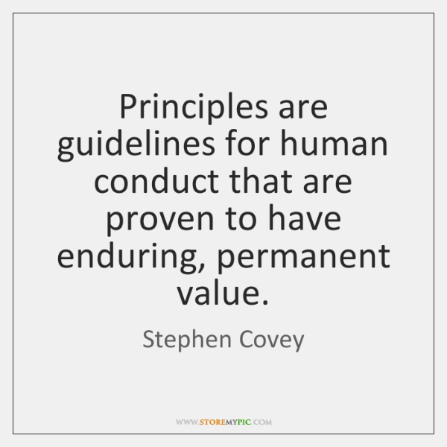
Forward in book
(p. 7-12)
“Success in any endeavor is always derived from acting in harmony with principles to which success is tied”
Principles are rules/laws that are universal, timeless, self evident, permanent, unchanging
fairness, integrity, honesty, respect
NOT values (not everyone agrees)
Problems occur when we step out of alignment with principles
“To achieve success & overcome challenges, identify & apply principles that govern results you seek”
Notes:
The forward introduces them to concepts to be taught later and gets them in the “zone” of assessing themselves and thinking about success. Most students think at this point (I just need to pass classes and I am in PT school and then complete my PT degree and I will be successful).
They are not thinking about this degree as much more than just passing classes. We have to change the culture.
Covey is trying to say our barriers are that we are not in alignment with principles and if we focus on establishing OUR principles that WE want to live by we begin to view our lives in a way to improving that alignment
Talk about the nine challenges he suggests most people face. In partners, have them write down the effect of living a life with these challenges so they can create strategies to overcome them. Have them write down and be ready to share how THEY OR someone they know has these.
principles are rules or laws that are permanent, unchanging, and universal in nature. Values are internal and subjective, and they may change over time. Make sure they define it this way not their interpretation. Make sure they differentiate between principles and values
Treaded others as you want to be treated is a principle: I doubt many would disagree with this, it exists in all cultures, for all time, it is obvious, and it wont change
Finding time to relax in nature is a value: still important but not all people see it that way, it is personal to you but not all people. You may not have appreciated it when you are young but do now to it is changing and not permanent.

Slide 13
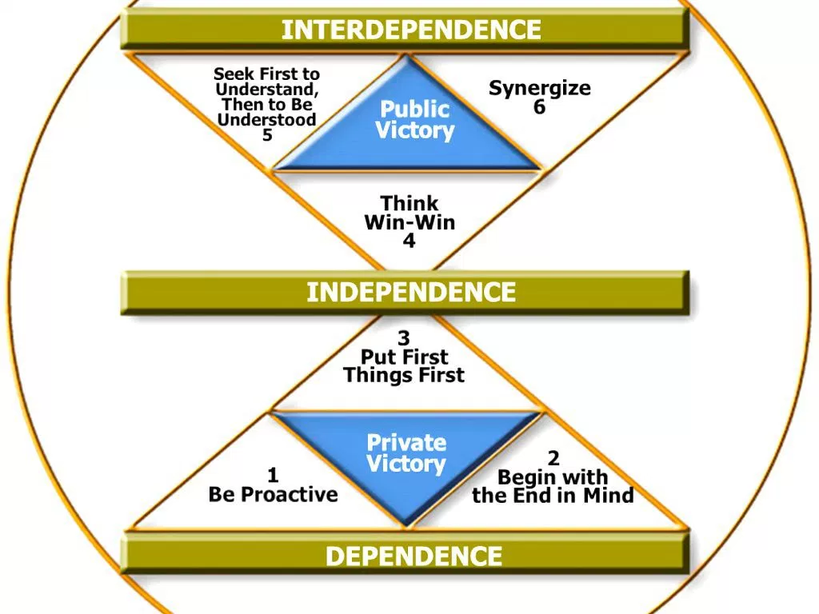
7 Habits of highly effective people
p. 15-20
p. 63
Notes:
Let students know this book is used for this course to help students to begin to develop their approach to success, life, career.
not meant to tell students what they do right or wrong OR even to tell them what to do, but rather to get them to reflect and to make decisions and begin to develop the approach it will take for their success.
Introduce the 7 habits in the figure, but do not go in depth, you are just introducing (ask students to learn them for next class)
Show them how the habits follow a process from dependence to independence to interdependence (these are major concepts and big test questions to explain)
Discuss the process of moving through 3 stages (dependence, independence, and interdependence. Give them brief idea of how everyone must progress through these steps (right now most students are somewhere between dependence and independence
Assignment 2: create vision, mission, values, address 9 challenges (make sure they know they will be quizzed/tested on each)

Slide 14
Most common challenges we face
Fear & Insecurity
I want it now
Blame & victimism
Hopelessness
Lack of life balance
What’s in it for me?
Drive to be understood
Conflict & differences
Personal stagnation
Group work:
3 or 4 per group
each member will take turns describing 1 of the challenges & providing a personal example to their group which demonstrates their understanding
Notes:
These are what Dr. Covey states are the 9 most common challenges that we ALL face that tends to interfere with success in any endeavor we pursue (we want to relate them to their education and career, but it can be relationships, family etc.)
Some students will say they do not have an example in their life, but if they think long enough they can come up with a situation
If they still say they cannot, then think of a friend or family member that has dealt with each
Don’t show or go over next slide, let them think these things through and discuss them
Randomly call on students to ensure they are all doing the work
Float through and listen to them talk

Slide 15
Most common challenges we face
Fear and insecurity:
Notes:
Review 1 challenge at a time and provide an example that you provide to them of something practical in careers that they can related to; then ask students to provide examples in their life; take time so they can think each through. Maybe have them in partners to talk it out first write down their ideas and then share them. Ask them if they notice they do these things; ask them if they know others that do them.
Each challenge I notice is real in so many people and get them to think the affect on their success.
Examples of what I see in students
I am afraid to volunteer for a board position. I will be a member of a club, but not hold a position
If I take 18 credits this semester I can graduate earlier (regardless of the fact that you are taking the most difficult courses)

Slide 16
Most common challenges we face
I want it now!
Notes:
Review 1 challenge at a time and provide an example that you provide to them of something practical in careers that they can related to; then ask students to provide examples in their life; take time so they can think each through. Maybe have them in partners to talk it out first write down their ideas and then share them. Ask them if they notice they do these things; ask them if they know others that do them.
Each challenge I notice is real in so many people and get them to think the affect on their success.
Examples of what I see in students
I am afraid to volunteer for a board position. I will be a member of a club, but not hold a position
If I take 18 credits this semester I can graduate earlier (regardless of the fact that you are taking the most difficult courses)

Slide 17
Most common challenges we face
Blame and victimism:
Notes:
Review 1 challenge at a time and provide an example that you provide to them of something practical in careers that they can related to; then ask students to provide examples in their life; take time so they can think each through. Maybe have them in partners to talk it out first write down their ideas and then share them. Ask them if they notice they do these things; ask them if they know others that do them.
Each challenge I notice is real in so many people and get them to think the affect on their success.
Examples of what I see in students
3. I am not a good test taker, never have been, just not good at it. Then do nothing to help yourself or work on it
4. If I can just pass; a C- is passing, maybe I can’t get into PT school so I will just accept something less that I do not want
5. Many students cannot integrate the necessary time to devote to their courses. There is just not enough time. There is, but we we are not spending it correctly.

Slide 18
Most common challenges we face
Hopelessness
When we become a victim to our circumstances
we lose hope, drive & settle on stagnation
Notes:
Review 1 challenge at a time and provide an example that you provide to them of something practical in careers that they can related to; then ask students to provide examples in their life; take time so they can think each through. Maybe have them in partners to talk it out first write down their ideas and then share them. Ask them if they notice they do these things; ask them if they know others that do them.
Each challenge I notice is real in so many people and get them to think the affect on their success.
Examples of what I see in students
3. I am not a good test taker, never have been, just not good at it. Then do nothing to help yourself or work on it
4. If I can just pass; a C- is passing, maybe I can’t get into PT school so I will just accept something less that I do not want
5. Many students cannot integrate the necessary time to devote to their courses. There is just not enough time. There is, but we we are not spending it correctly.

Slide 19
Most common challenges we face
Lack of Life Balance
Balance & peace of mind do not come from working harder or more; rather developing a clear sense of your highest priorities & live with focus/integrity toward them
Notes:
Review 1 challenge at a time and provide an example that you provide to them of something practical in careers that they can related to; then ask students to provide examples in their life; take time so they can think each through. Maybe have them in partners to talk it out first write down their ideas and then share them. Ask them if they notice they do these things; ask them if they know others that do them.
Each challenge I notice is real in so many people and get them to think the affect on their success.
Examples of what I see in students
3. I am not a good test taker, never have been, just not good at it. Then do nothing to help yourself or work on it
4. If I can just pass; a C- is passing, maybe I can’t get into PT school so I will just accept something less that I do not want
5. Many students cannot integrate the necessary time to devote to their courses. There is just not enough time. There is, but we we are not spending it correctly.

Slide 20
Most common challenges we face
What’s in it for me? Culture “look out for number 1” “life is a game, a race, a competition, & you must win
Greatest accomplishments are for those who master the art of “we”. True greatness is achieved through a mind that works selflessly, mutual respect, mutual benefit
Notes:
6. Investing time into volunteering. What do I get out of it? Understandable, but if you cannot see the value then you don’t do it and miss out on an opportunity to experience something that might benefit you in the end. Changing study habits.
Example: I could teach and just worry about my courses; however, what everyone else does in their courses affects my students; attendance, cell phones, rigor, etc.
-we need to recognize WE benefit when we help others.
-ask students for examples of what they have done that ended up helping them because of their desire to think of others first
7. People don’t want to hear your story, they want to tell their own.

Slide 21
Most common challenges we face
The Hunger to be understood: most believe key to influence in communication: getting your point across clearly/speaking persuasively
While others speak, instead of listening are you preparing your response?
Real influence comes when others sense you are being influenced by them, when they feel understood by you
Most are too focused on our agenda to listen
“People don’t care how much you know until they know how much you care”
Notes:
6. Investing time into volunteering. What do I get out of it? Understandable, but if you cannot see the value then you don’t do it and miss out on an opportunity to experience something that might benefit you in the end. Changing study habits.
Example: I could teach and just worry about my courses; however, what everyone else does in their courses affects my students; attendance, cell phones, rigor, etc.
-we need to recognize WE benefit when we help others.
-ask students for examples of what they have done that ended up helping them because of their desire to think of others first
7. People don’t want to hear your story, they want to tell their own.

Slide 22
Most common challenges we face
Conflict and differences:
We all see things differently & can be right (images in book)
We center differences on winning rather than understanding others views
Seek clarity before agreeing or disagreeing (understand first).
We lose out when we do not listen to other views
What is it that you thought was so right but later you realized other views would have been more successful?
Did you rush to judgement of a person & later find out you were completely wrong?
Notes:
Each challenge I notice is real in so many people and get them to think the affect on their success.
8. We spend more time arguing our point then listening. We cannot grow if we think we are always right
9. We need to focus on the here and now, but we need to think about the future effect our decisions have

Slide 23
Most common challenges we face
9. Personal Stagnation
Stagnation is the default position when you are not moving forward and growing
e.g. body, relationships, etc.
Notes:
Sitting back and waiting and not constantly trying to improve yourself
Look at each area and how most people address it

Slide 24
Questions?
Notes:
They will need to complete assignment 2 for a grade so they need to continue there work on vision, mission, and 9 challenges
They will be tested on details of all of this

