Slide 1
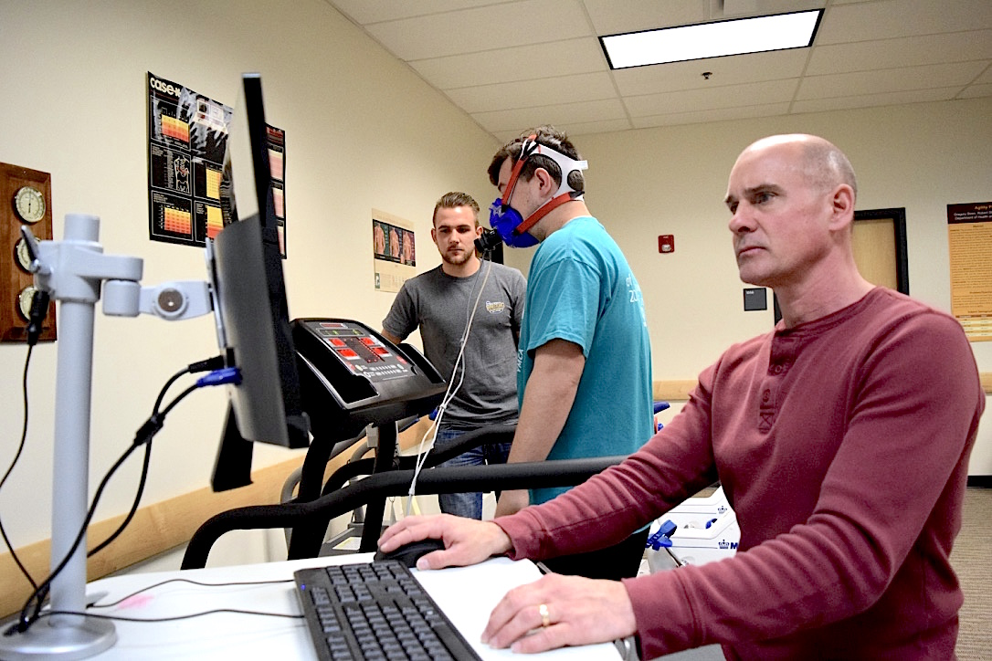
Developing a Research Project

Slide 2
Scientific Question
Ask a Question
Do Background Research
Construct a Hypothesis
Test Your Hypothesis by Doing an Experiment
Analyze Your Data and Draw a Conclusion
Communicate Your Results

Slide 3
Ask a Question
What interests you?
Have you ever had a question that you couldn’t find an answer too?
What are others around you interested in?
What equipment do you need or have access too?
metabolic cart, body composition, range of motion, strength/endurance equipment, blood pressure/heart rate, EKG, EMG, pulmonary and lactate testing, power and speed assessments, functional movement assessments, agility and balance

Slide 4
You have an Idea, what comes next?
What is a literature Review?
(one research study per student in the group)
Answers the following questions
What do we already know, what don’t we know?
What have others already tried?
What worked and what didn’t work?
Review the previous studies or related research
Demonstrates the need for your project
What new question are you going to answer?

Slide 5
Literature Review
Identify topic specific database
Web of Science: includes indexes to articles on art/humanities social sciences, AND Science. >8,400 scholarly journals are indexed
PubMed Indexes over 4,000 biomedical, nursing, dentistry and related journals. Good for health topics.
Rowan Library
Notes:
Boolean Operators are used to connect and define the relationship between your search terms.

Slide 6
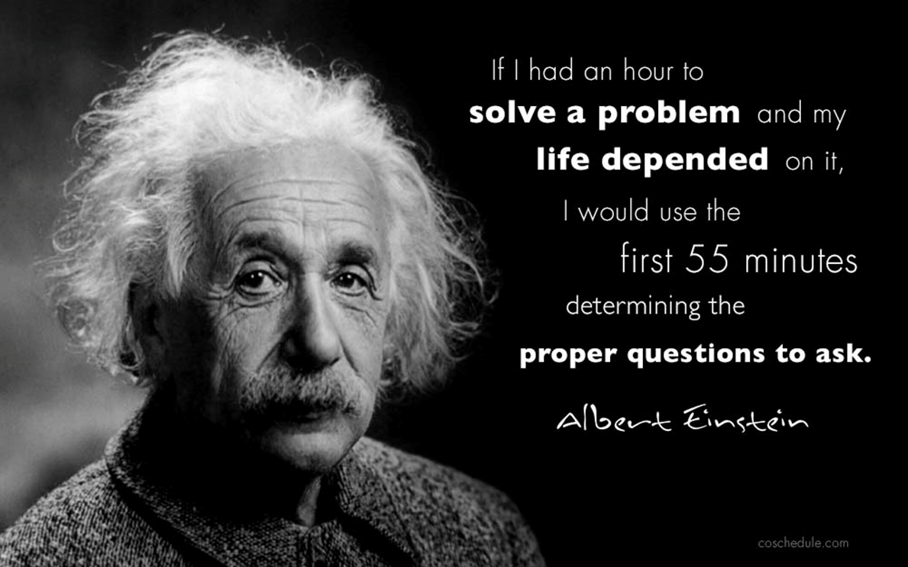
Construct a Hypothesis
What is your question? Is it testable?
What information is missing?
What is the benefit to answering your question?
How can you fill the knowledge gap?
What do you expect?
You should design your hypothesis based on what you expect to find

Slide 7
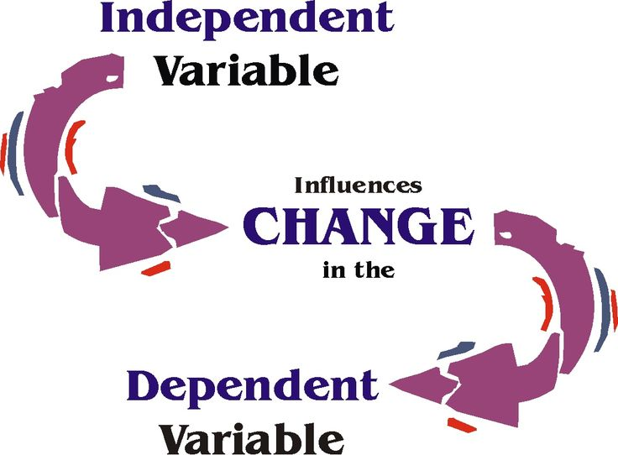
Determine the Methodology
Subjects
Dependent Variable
How the independent variable is measured
Independent Variable- variable of interest (”cause”). What you are studying
Testing Procedures/Protocols (Experimental Treatment)
Statistical Analysis
Make-up results/conclusion
Notes:
A variable is an object, event, idea, feeling, time period, or any other type of category you are trying to measure
How does the time spent studying affect test scores.

Slide 8
Test Your Hypothesis by Doing an Experiment
What is your Timeline?
Timeline determines study design
Cross-sectional (snap-shot of what is happening at one point in time)
Retrospective (a review of data already collected)
Longitudinal (multiple data collections over time)
What equipment and facilities do you have access to?
It does not matter how good of an idea you have if you don’t have the means investigate your idea
Writing a grant gets you access to new equipment and facilities
Is there something that you will need help with?
Identify people within your research community that may be interested and willing to help

Slide 9
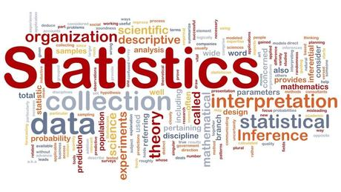
Statistical Analysis and Conclusion
Describe and summarize the data
descriptive statistics (mean, median, standard deviation)
Identify relationships between variables (correlations)
Compare variables (t-test)
Identify difference between variables
ANCOVA, MANCOVA
Forecast outcomes (odds ration, logistic regressions, linear regressions)
Notes:
correlation between two sets of data, it means they are connected in some way. (leg length and vert jump)
t-test is an analysis of two populations means through the use of statistical examination

Slide 10
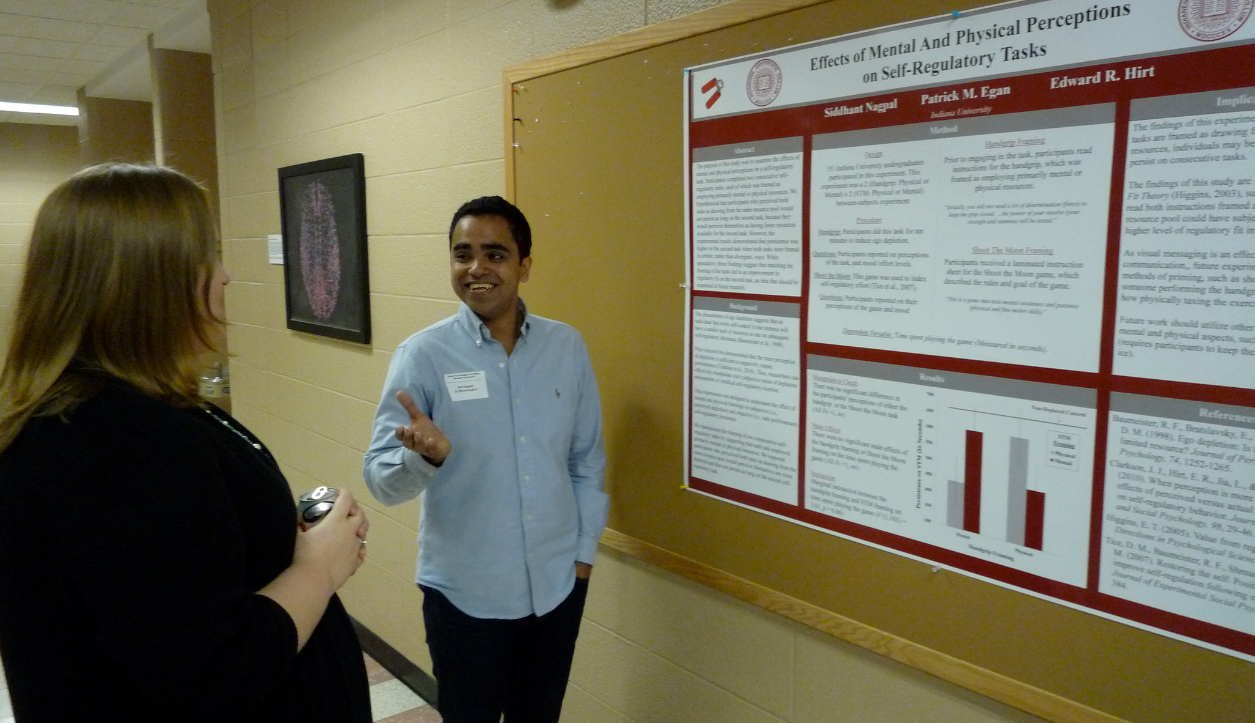
Communicate Your Results
How do your findings compare to others?
What new information was learned?
Limitations of your research
How does our understanding change based on your new findings?
Is further research warranted?

Slide 11
Questions on Research??

