Slide 1
BRAIN STructures
CENTRAL NERVOUS SYSTEM

Slide 2
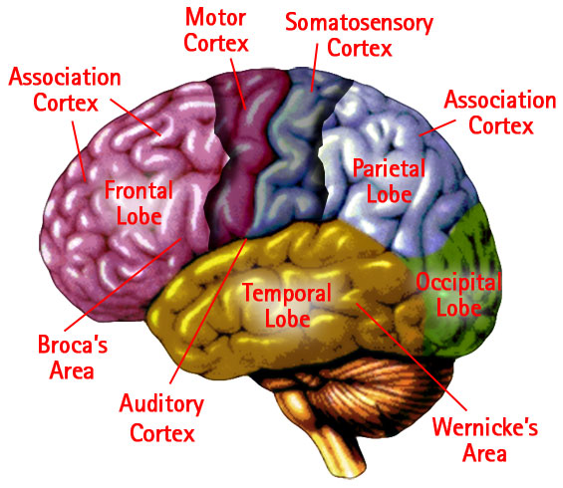
Celebral Cortex – wrinkled surface , millions of neurons regulating many functions & behaviors:
Motor Cortex is part of this structure.
It controls voluntary movement

Slide 3
Parietal Lobe – integrates sensory info relating to navigation ( also important to language), etc.
Frontal Lobe – problem solving, planning, personality, etc.

Slide 4
Occipital Lobe-visual perception, color recognition
Temporal Lobe- auditory perception, memory, speech, emotions.

Slide 5
Brain has property of plasticity, i.e. it changes and evolves constantly in response to demands, use, environment, and stimuli
With injury to one area, other areas can pick up that function with the proper stimuli (therapy).

Slide 6
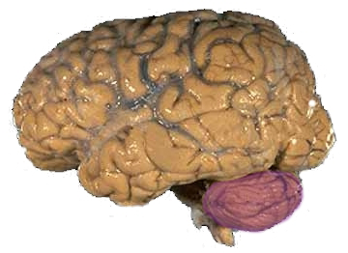
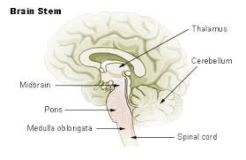
Lower Brain Structures
More advanced at birth
than higher brain centers
Cerebellum-
Brain Stem-
control respiration,
food intake, reflexes,
reactions,

Slide 7
Spinal Cord and Nerve Tracts
Myelin-an insulating sheath of cells (glial & fat ) that wrap around axons. ( at birth un-m)
Development of myelin (around neurons) contributes to speed of nerve impulses
High –level function – only when neurons are myelinated allowing faster and more frequent conduction of nerve signals.
Multiple Sclerosis – deterioration of the myelin sheath,= poor conductivity and communication between nerves & muscles.
Spinal Cord- relatively small & short at birth

Slide 8
Spinal Cord and Nerve Tracts
Sensory pathways – info toward the brain
Motor pathways – from the brain to the muscles
Two major tracts:
1) Extrapyramidal pathway- random & postural movements (7 days after birth, involuntary, reflex)
2) Pyramidal pathway – myelinates after birth, functioning 4-5 months, controls muscles for finger movements (voluntary movements)
3) Myelination occurs in Motor Tracts from brain to Spinal Cord (direction of messages) and in Sensory Tracts from sensory receptors to SC and Brain (direction of impulses)
Sensory Pathways mature before motor pathways.

Slide 9
Nervous System & Aging
Neurogenesis- the propagation of nerve cells (division and production of additional nerve cells) . Neurogenesis can occur with age just as muscle cells can grow at any age.
Overall, the nervous system slows down and declines with age. Due in part to inactivity and less active pathways (use it or lose it) and aging of the body.

