Slide 1
Consumer Health Decisions PowerPoint # 7
Based on readings from Barrett, et. al. chapters 11, 25

Slide 2
Chapter Objectives
Define and explain the term “dietary supplements.”
List reasons that people use supplements.
Discuss the benefits and hazards of supplements.
Discuss characteristics of people who might benefit from using supplements.
Explain some of the risks of using herbs as remedies.
Explain the federal regulation of dietary supplements.

Slide 3
Facts About Supplements
More than 1000 new supplements are developed each year. Market is over $29 billion
Large and small companies produce supplements.
Supplements have been touted to treat almost _____condition known to man.
Claims by those who market supplements frequently have ____ basis in science.
People take supplements for a variety of reasons.
Only about a _____ of dietary supplements have scientific evidence of safety and effectiveness.
Supplements can interact with medications.

Slide 4
Regulation of Dietary Supplements
The U.S. F____T_____C_____ has primary responsibility for regulating advertisement and labeling.
Aside from advertising, regulation is by the Food and Drug Administration.
FDA regulation is hampered by the fact that supplements are usually treated as foods, not drugs.
FDA does not_____the content of supplements and cannot insure the ingredients or their amounts listed on the label are accurate.

Slide 5
1994 Dietary Supplement Health & Education (DSHEA) Act Definition of a dietary supplement:
It is a product that is intended to supplement the diet and that contains_____or _____ of the following: _______, minerals, _____ or botanicals, amino acids, a dietary substance used “…to supplement the diet by increasing dietary intake” (weight gainer), or any combination of the above ingredients.

Slide 6
Dietary Supplement Health and Education Act
Governs federal regulation of dietary supplements.
Specified the ingredient and label information.
Prohibits the FDA from banning suspicious ingredients.
Allows label statements about the products influence on body structure or its effects on how the body functions, if they contain a _________ statement.
“This product is not intended to diagnose, treat, cure or
prevent any disease”
Broadened the meaning of the term to include more products as dietary supplements
Requires good manufacturing practices.

Slide 7
Vitamins and Minerals
Basic nutrients (6) necessary to support life.
Widely dispersed in food.
Marketed with a wide array of claims.
The most ________ reason for taking supplements is to overcome ______, which can only be diagnosed by a physician.
Taking excessive amounts can result in health problems.
Supplements are no guarantee against disease.

Slide 8
Examples of People Who May Need Vitamin/Mineral Supplements
Those whose diets are poor
_______ or nursing women
Young children
______________
Those who consume less than 1200 calories/day
Smokers
Heavy drinkers

Slide 9
Examples of People Who May Need Vitamin/Mineral Supplements
Postmenopausal women
______ persons
Women with heavy menstrual bleeding
Those with a _____ condition that affects absorption, use, or excretion of nutrients.

Slide 10
Vitamins/Minerals: Reducing Risk
Look for “USP” on the label.
Check the label for contents.
Reject supplements that provide “megadoses.”
Beware of label and advertising claims.
Observe _______ dates.
Store supplements wisely.
Take supplements carefully.

Slide 11
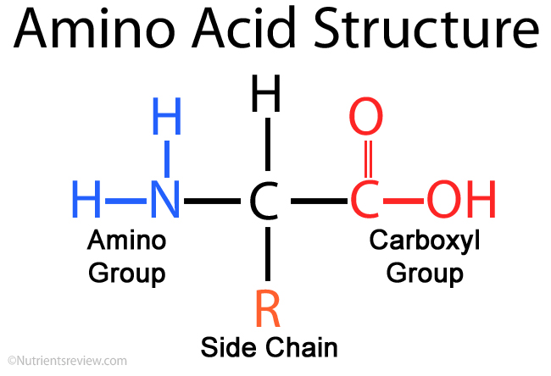
Amino Acids
The constituent parts of proteins
Essential amino acids must be _________
Supplements may pose risk for some people, including:
Pregnant or _____ women
Infants
Children and adolescents
The elderly
Those with ________disorders of amino acid metabolism
Those with certain diseases

Slide 12
Herbal Supplements
Naturally occurring substances taken from parts of _______
Herbal remedies have a long history.
Herbal supplements may act in the same way as drugs.
Herbals may ______ with medications, vitamins, and minerals.
Side effects may be unpredictable.

Slide 13
Herbal Supplements
Few have been ______ in controlled studies for effectiveness and safety, especially in children.
May not always contain the ingredient(s) listed on the label or in the amounts stated on the label.
Some have been contaminated.

Slide 14
Research
Research is_________regarding the benefit and risk of many supplements.
NCCIH funds scientific studies on supplements.
Using high doses of vitamins or vitamin insurance must take into account the bioavailability of the supplement, symptoms of overdose, and the possible damage to one’s health.
The RDA is an established guideline to meet or exceed the nutritional needs of most people. They are evaluated and updated every ten years.

Slide 15
Reducing Risk
Speak with your health care provider.
Speak with a dietician and a pharmacist.
Always let your health care providers know what you are taking.
Read the _______ research.
Follow label directions.
Avoid “megadoses.”
Avoid supplements that contain hormones or steroids.
Stop taking it if side effects develop.
Look for the “USP Verified” mark.
Visit the FDA and NCCIH websites for current information.

