Slide 1
Development of Cardiorespiratory Endurance
Chapter 10

Slide 2
Cardiorespiratory (CR) Endurance and Children
The worldwide trend is toward reduced fitness.
A high percentage of children in Western societies have risk factors for heart disease.
CR endurance reflects the ability to sustain vigorous activity.
Many activities demand vigorous exertion.
CR systems are related to endurance level.

Slide 3
Physiological Responses to Short-Term Exercise
During brief intense activity, oxygen reserves and energy sources are depleted.
Such activity is termed anaerobic (without oxygen).
Anaerobic power is the rate at which the body can meet demand for short-term intense activity.
Anaerobic capacity is the maximum oxygen deficit the body can tolerate.
(continued)

Slide 4
Physiological Responses to Short-Term Exercise (continued)
As the exercise period lengthens, the anaerobic system contributes less and the aerobic system takes over.
What are some anaerobic activities?

Slide 5
Developmental Changes in Anaerobic Performance
Anaerobic performance is related to the following:
Body size
Ability to metabolize fuel sources in the muscles
Quick mobilization of oxygen delivery systems
Some of these factors change with growth.

Slide 6
Children Have a Smaller Output of Absolute Anaerobic Power
Children have less anaerobic power output than adults.
Muscle mass is smaller.
Absolute quantities of energy reserves are smaller.

Slide 7
Developmental Changes in Anaerobic Performance With Growth
Energy reserves increase (muscle mass increases).
Tolerance of by-products of metabolic process improves.
Mean and peak anaerobic power improve.

Slide 8
Individual Differences in Anaerobic Performance
Gender differences reflect muscle mass differences.
Improved neuromuscular coordination contributes to improved performance of anaerobic activities.
More mature children have better anaerobic performance.

Slide 9
Implications for Children’s Programs
What are the implications of the link between maturation and anaerobic performance for physical education teachers?
What are the implications for youth sport programs?

Slide 10
Anaerobic Training in Youth
With training, children and adolescents of both sexes have higher peak power and mean power.
When children stop training, peak and mean power decrease.

Slide 11
Anaerobic Performance in Adulthood
Once adult body size is attained, anaerobic performance is stable.
Improvement reflects training alone.
In older adulthood, a loss of muscle mass and type II muscle fibers can result in declining anaerobic performance.

Slide 12
Gender Differences
Men maintain their advantage over women in anaerobic performance.
Men and women decline sharply after age 70, but women decline significantly faster.

Slide 13
Assessing Anaerobic Performance
Anaerobic performance (tasks 10–30 seconds long)
Typically, total work output is measured.
Possible field tests include 50-yard or 50-meter dash or sprinting flight of stairs.

Slide 14
Anaerobic Training in Adulthood
Sedentary older men undertaking high-intensity endurance training improved in work output on an anaerobic capacity test.
Masters athletes who undergo anaerobic or resistance training improved anaerobic performance.
Resistance training is valuable.

Slide 15
Physiological Responses to Prolonged Exercise
During a prolonged period of activity, the following responses occur:
Oxidative breakdown of food stores
Depletion of local energy reserves
Aerobic power is the rate at which long-term oxygen demand is met.
Aerobic capacity is the total energy available for prolonged activity.
(continued)

Slide 16
Physiological Responses to Prolonged Exercise (continued)
The body increases heart and respiratory rates, cardiac output, and oxygen uptake to deliver oxygen to muscles.
Cardiac output can increase through increased heart rate or increased stroke volume.

Slide 17
Peak Oxygen Uptake
It is defined as the highest rate oxygen can be consumed by the muscles during aerobic work.
A limiting factor to continued vigorous activity is the heart’s ability to pump enough blood to meet the oxygen needs of the working muscles.
(continued)

Slide 18
Peak Oxygen Uptake (continued)
It is strongly related to lean body mass.
Absolute peak oxygen uptake increases linearly throughout childhood and adolescence.
Maximal oxygen uptake per kilogram of body weight is then stable in boys and declines slightly in girls.

Slide 19
Changes in Aerobic Performance During Childhood
Children have smaller stroke volume and thus smaller cardiac output (hypokinetic circulation).
Children compensate in part with higher heart rates.
Children have lower concentrations of hemoglobin (the blood protein that carries oxygen).
Children have an efficient system but cannot exercise for as long as adults can.
(continued)

Slide 20
Changes in Aerobic Performance During Childhood (continued)
With growth and maturation, the following occur:
Heart size increases.
Hemoglobin concentration increases.
Oxygen-extraction ability decreases to adult levels.
Ability to sustain exercise is related to body size and maturity level.
By late adolescence and into adulthood, trained men have an advantage over trained women.

Slide 21
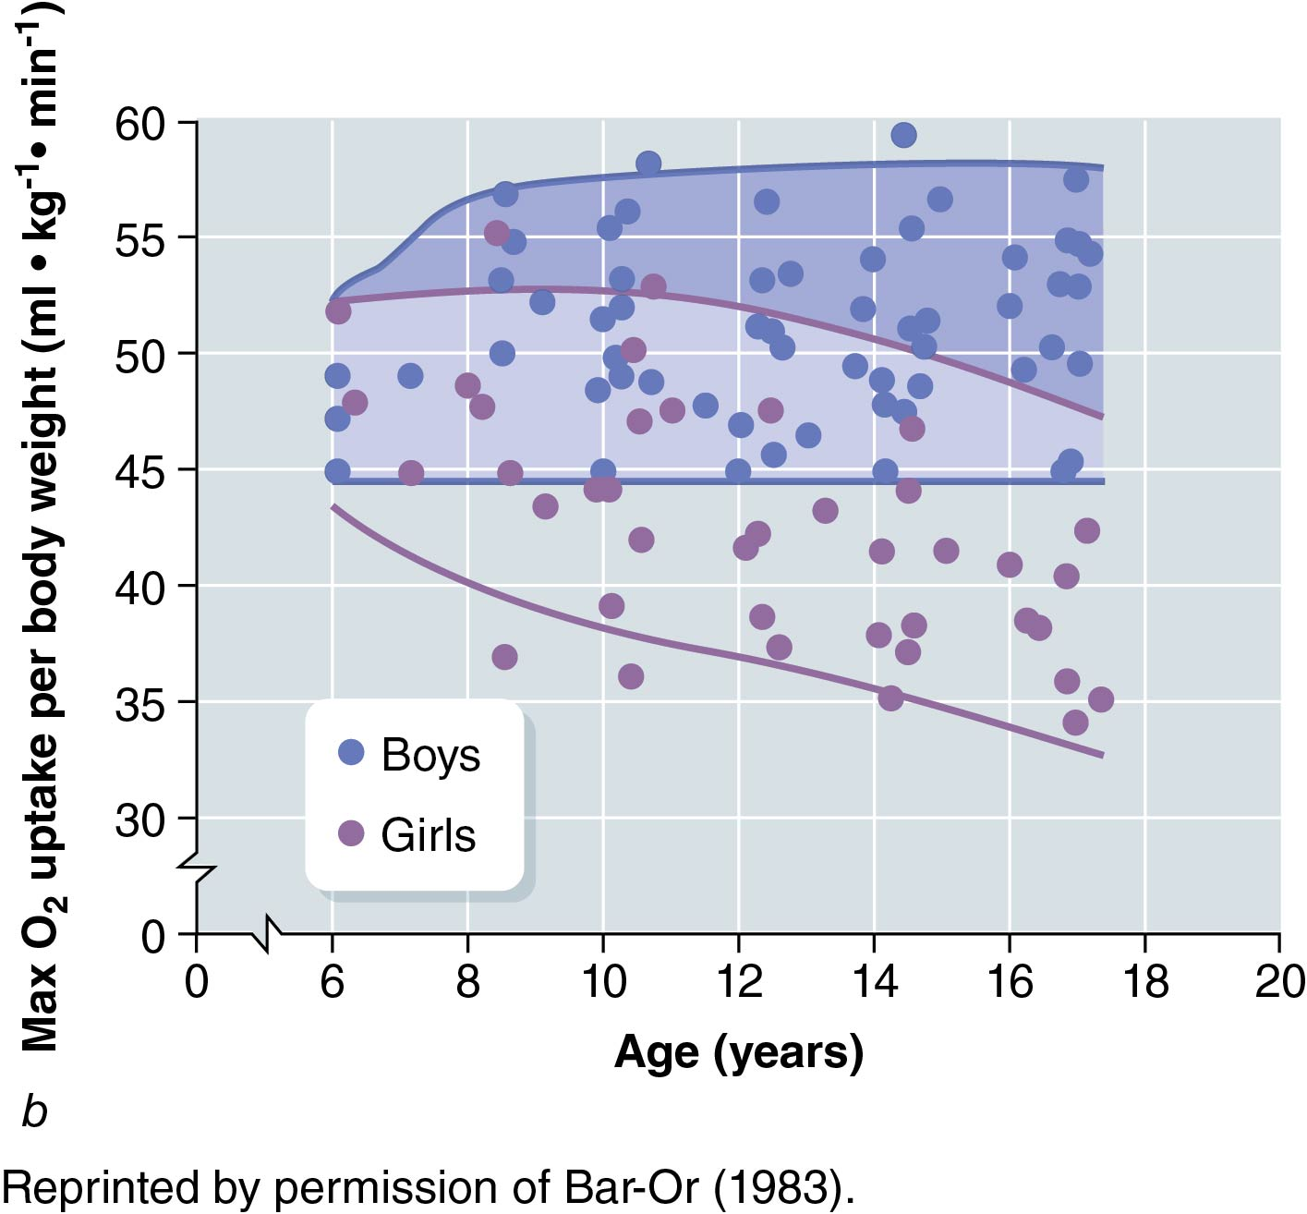
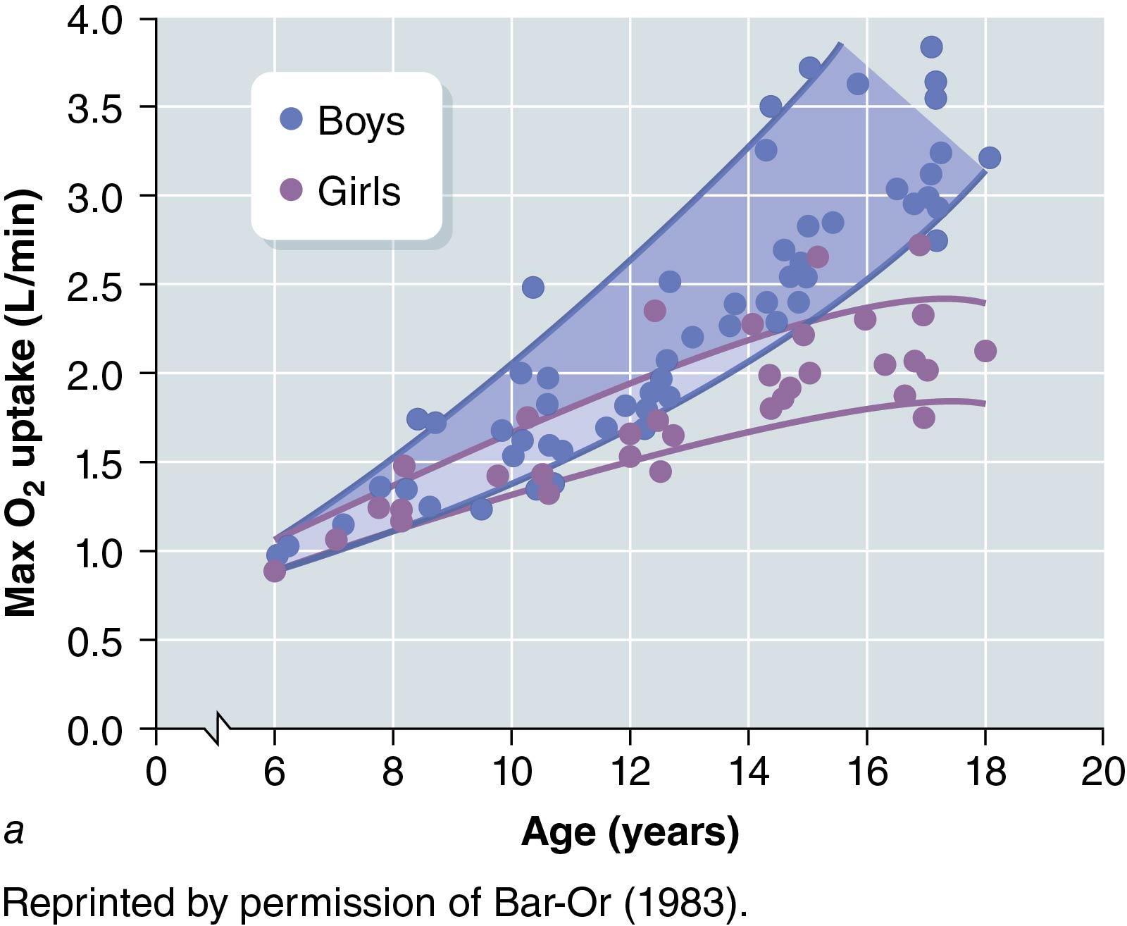
Figure 10.2: Relationship Between Peak Oxygen Uptake and Age

Slide 22
Training Effect in Children
Growth status and maturation level must be considered.
Early studies were equivocal.
Training intensity is important.
Sufficiently intense training improves peak oxygen uptake regardless of age, stage of maturation, or sex.
More research on children is needed.
Aerobic training yields significant improvements after puberty.

Slide 23
Aerobic Performance in Adulthood
Average maximal oxygen uptake per kilogram of body weight falls about 1% per year after the 20s.
Athletic and active adults maintain higher maximal oxygen uptake than do sedentary adults.

Slide 24
Cardiovascular Structure and Function
Changes occur in structure and function in adulthood:
Loss of cardiac muscle
Loss of elasticity in cardiac muscle
Thickening of left ventricle
Fibrotic changes in valves
Loss of elasticity in major blood vessels
(continued)

Slide 25
Cardiovascular Structure and Function (continued)
Changes occur in structure and function in adulthood:
Maximum achievable heart rate with exercise declines.
Stroke volume in some older adults declines.
Cardiac output declines.
(continued)

Slide 26
Cardiovascular Structure and Function (continued)
Implications
What middle and older adult lifestyles maintain cardiorespiratory endurance?
What lifestyles are detrimental to cardiorespiratory endurance?
How might school teachers educate children about these effects while they are still young?

Slide 27
Assessing Aerobic Performance
Aerobic performance (longer exercise bouts)
Performance may be graded (get more intense in stages).
Effort can be maximal or submaximal.
Peak oxygen uptake is often measured to see how efficiently participant uses oxygen.
Can measure highest exercise load tolerated before exhaustion, but this carries risk.
A 1,600-meter run can be used as a field test for youth.

Slide 28
Respiratory Structure and Function
Changes occur with aging:
Elasticity of lung tissue declines.
Vital capacity decreases, especially in smokers.
Oxygen–carbon dioxide exchange loses efficiency.

Slide 29
Training Programs in Adulthood
Peak oxygen uptake is higher in those who train.
Declines are not as dramatic in training adults.
Even sedentary adults can improve their peak oxygen consumption with training and even in older adulthood.
Muscle mass increases with training.
Training adults have a larger vital capacity.
(continued)

Slide 30
Training Programs in Adulthood (continued)
Adults who remain active decline in aerobic endurance only gradually.
Sedentary adults who begin training can increase maximal oxygen uptake and improve blood lipid levels.
Improvement is associated with increased muscle mass.
(continued)

Slide 31
Training Programs in Adulthood (continued)
Maximal oxygen uptake increases.
Stroke volume increases.
Maximal cardiac output increases.
Oxygen is better extracted from blood at muscle sites.
Ventilation improves.

Slide 32
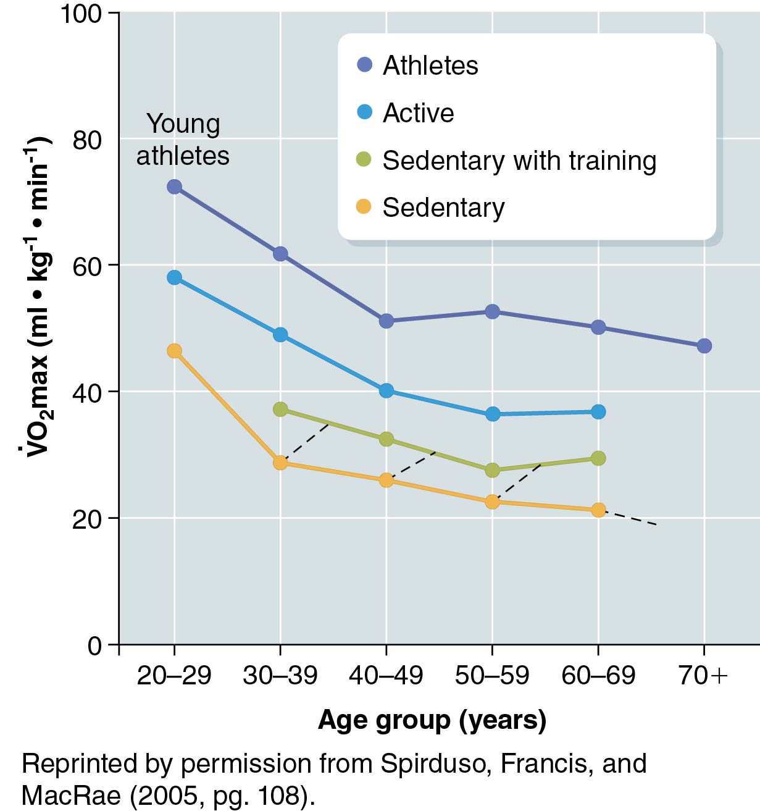
Figure 10.6: Peak Oxygen Uptake Values in Adults

Slide 33
Endurance Training
Implications
What implications do the developmental trends in aerobic training effects have for physical education programs?
Should physical education classes spend substantial time on aerobic exercise? Why or why not?

Slide 34
Long-Term Training Effects
Research is limited (especially longitudinal).
Women with more physical education during their youth exercised more frequently in adulthood. (Trudeau, Laurencelle, Tremblay, Rajic, & Shephard 1998)
Youth sport participation predicts young adult activity levels. (Telama, Yang, Hirvensalo, & Raitakari, 2006)
(continued)

Slide 35
Long-Term Training Effects (continued)
Saltin and Grimby (1968)
Maximal oxygen uptake was measured in men 50 to 59 and categorized by activity.
Subjects were asked about activity in youth.
Those engaged in lifelong activity had the highest maximal oxygen uptake measures.
Sedentary adults who had been active in youth had higher measures than those who had been inactive in youth.
(continued)

Slide 36
Long-Term Training Effects (continued)
Implications
What implications do studies of training’s lifelong effects have for parents of young children?

Slide 37
Effects of Diseases on Endurance Performance
Short-term infectious disease reduces working capacity by varying degrees.
Those with long-term diseases should never be placed at risk.
Parents, educational staff, and medical staff should form a team to determine safe levels of activity.
Participants should be monitored closely.

Slide 38
Summary and Synthesis
Cardiorespiratory endurance improves with body growth.
Training, especially after puberty, improves endurance.
If training is not maintained, benefits will reverse.
Gender differences exist after puberty.

