Slide 1
Endocrine system
Chapter 5 Continued.

Slide 2
Endocrine System
The endocrine system regulates control of cells of the body for specific functions, through substances known as hormones (powerful chemicals that produce specific and powerful effects on the body).
Hormones secreted by the Hypothalmus (brain) regulate/control the pituitary gland which regulates/controls the adrenal gland, thyroid gland, etc.
Endocrine system is a complex interaction of the brain, glands, and hormones.

Slide 3
Endocrine System Glands
Pituitary (anterior and posterior)- H.G.H during childhood & adolescence by stimulating protein anabolism so that new tissue is built.
Thyroid- Thyroxin, growth, and skeletal growth
Adrenal Glands (medulla & cortex)- adrenaline, cortisol- anti-inflammatory (small amounts of testosterone)
Pancreas- insulin- CHO uptake and transport
Kidneys- hormones affecting RBC & Vitamin D production
Gonadal Hormones
Testes-androgens fuse bones, protein synthesis, increase rate of muscle growth
Ovaries- estrogen, bone maturation, fat accumulation in breasts and hips( (small amounts of testosterone)
Liver- hormones affect clotting, iron levels, overall growth

Slide 4
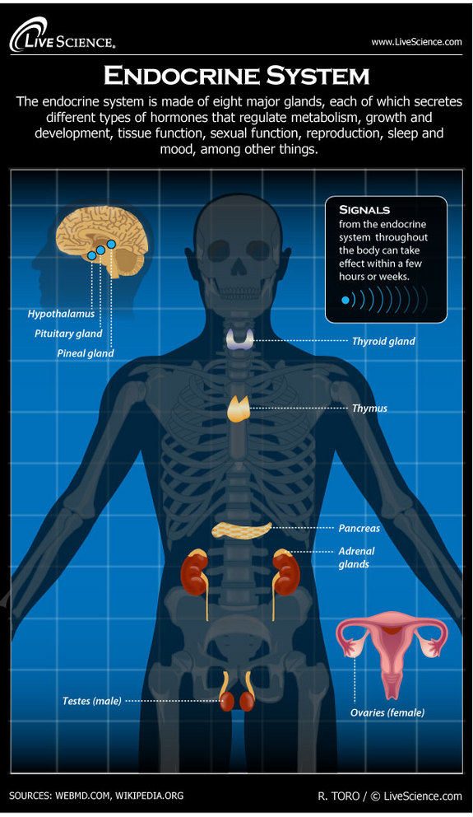
Endocrine video
Regulation of Growth- balance of interactions of hormones, genes, nutrients & environmental factors. Timing is critical

Slide 5
Endocrine into Adulthood
Thyroid function decreases with age
Thyroid disorder more prevalent among older adults
(hyperthyroid- congestive heart failure)
(hypothyroid- accelerated aging)
Gonadal (sex) Hormones decrease with age
Type 2 diabetes increase with age
Insulin sensitivity decreases

