Slide 1
Chapter 7
C H A P T E R
5
Development of Human Locomotion

Slide 2
What Is Locomotion?
Moving from place to place
Moving on one, two, or four limbs
  Crawling, walking, running
  Hopping, skipping, galloping, using other modes

Slide 3
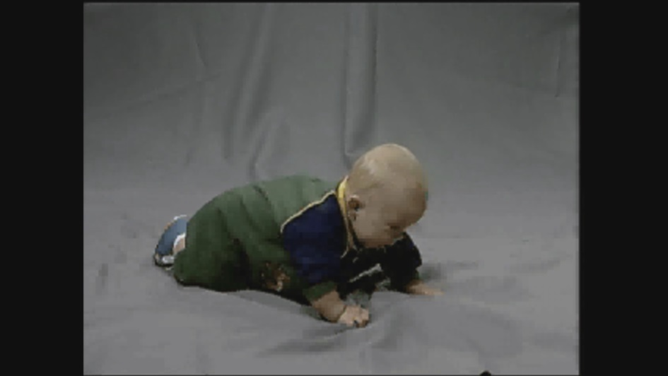
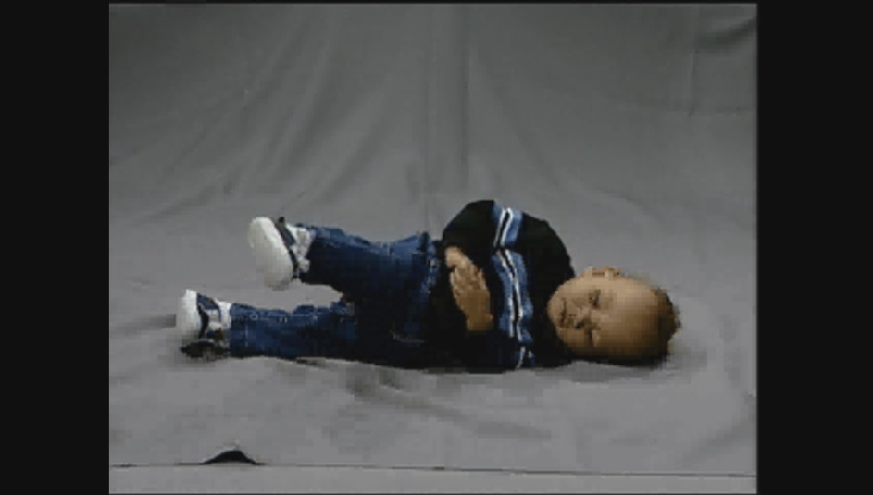
Video 7.1: Early Locomotion
Crawling (“commando crawl”): moving on hands and abdomen
Creeping: moving on hands and knees
Other forms of early locomotion
Click image to view video
Click image to view video
Notes:
Click to add notes

Slide 4
Walking
Walking is the first form of upright, bipedal locomotion.
Walking is defined by
  50% phasing between the legs (Clark, Whitall, & Phillips, 1988)
  period of double support (both feet on the ground) followed by period of single support

Slide 5
Early Walking
Maximizes stability and balance over mobility
Arms are in high guard.
Feet are out-toed and spread wide apart.
Independent steps are taken.
Rate controllers are strength (to support body on one leg) and balance.
(continued)

Slide 6
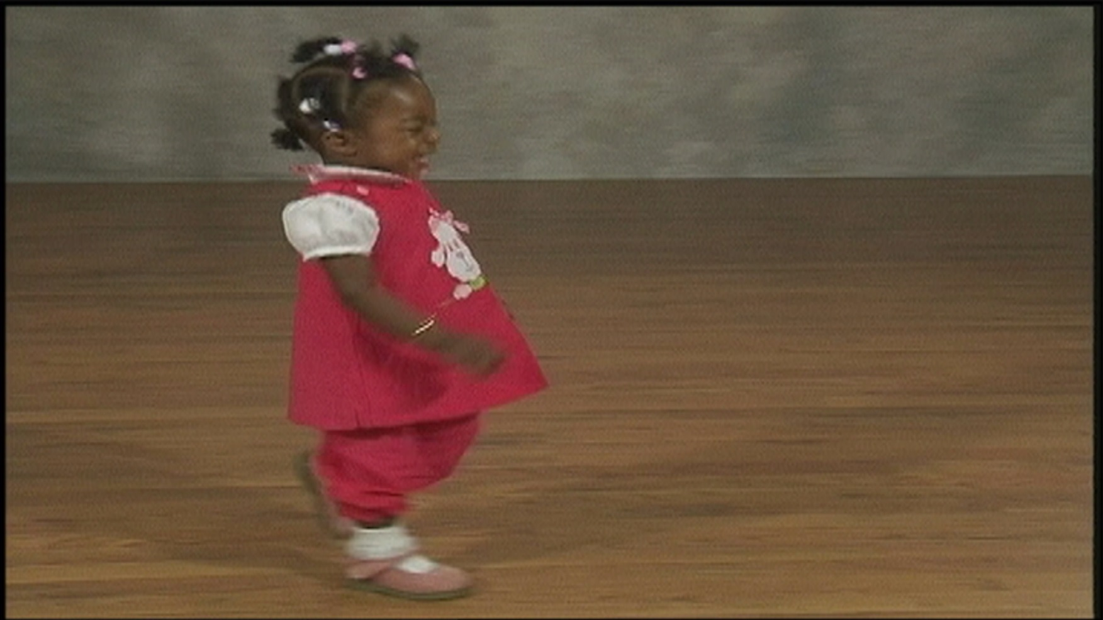
Video 7.2: Early Walking (continued)
Click image to view video

Slide 7
Rate Limiters in Early Walking
How could balance, strength, and/or coordination act as rate limiters for creeping and crawling?

Slide 8
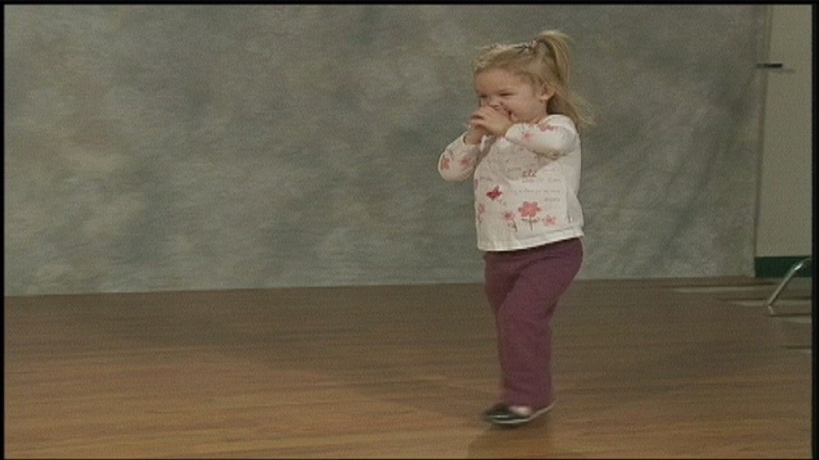
Video 7.3: Proficient Walking
Trading stability for mobility
Stride length increases.
Base of support is reduced.
Pelvis is rotated.
Opposition (arms to legs) occurs.
Click image to view video

Slide 9
Developmental Changes in Walking
Early childhood:
  By age 4, essential components of an advanced walk are present
Older adulthood:
  Maximizing stability
  Out-toeing increases.
  Stride length decreases.
  Pelvic rotation decreases.
  Speed decreases.
  Objects are used as balance aids.

Slide 10
Rate Controllers in Later Walking
Any of the changes associated with the aging process can act as rate controllers
Most obviously, changes in structural constraints can influence walking

Slide 11
Running
Occurs 6 to 7 months after walking starts.
Defined by
  50% phasing between the legs
  flight phase followed by single support

Slide 12
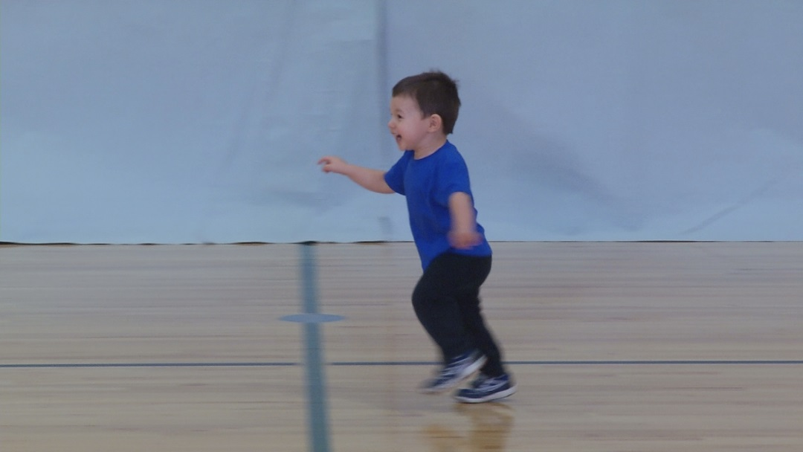
Video 7.4: Early Running
Stability over mobility: return of “old behaviors”
Arms in high guard, limited range of motion, short stride length, little rotation
Click image to view video

Slide 13
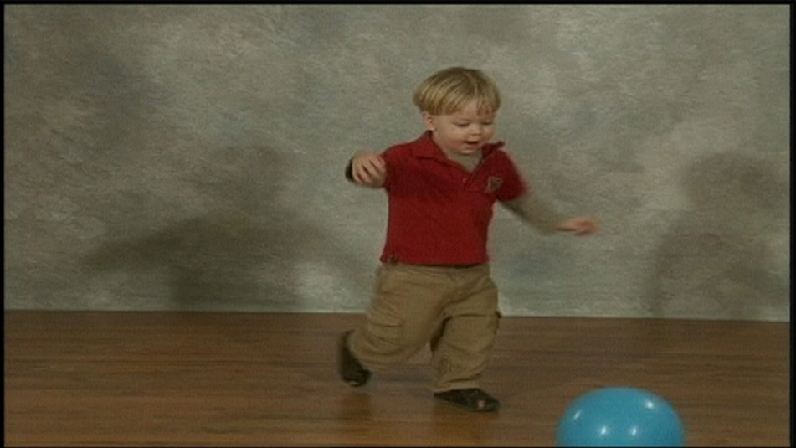
Video 7.5:
Rate Limiters in Early Running
What primary rate limiters keep a new walker from running? How?
Click image to view video

Slide 14
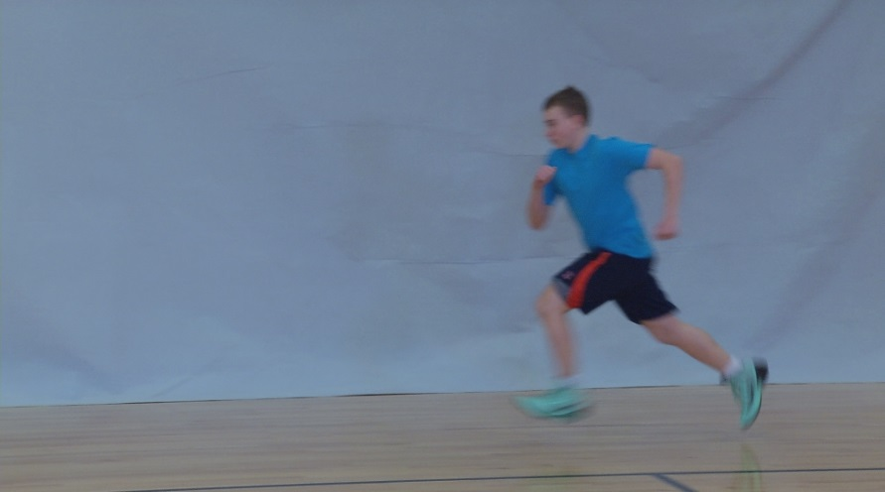
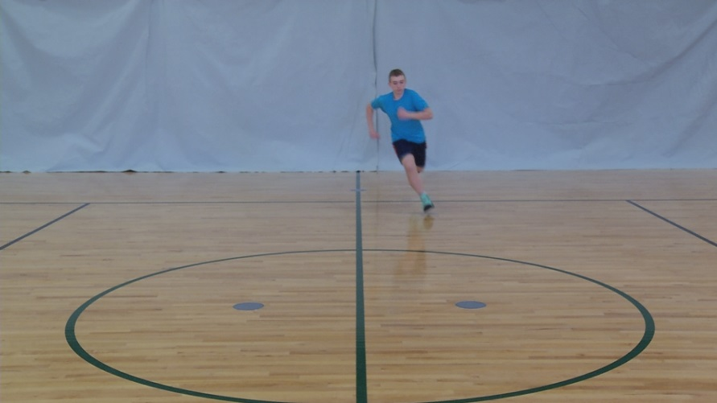
Video 7.6: Proficient Running
Less stability, more mobility
Increased stride length
Planar movement
Narrow base of support
Trunk rotation
Opposition
Click image to view video
Click image to view video
Notes:
Click to add notes

Slide 15
Developmental Changes of Running
Early running:
  As children grow, qualitative changes in running patterns, combined with physical growth and maturation, generally result in improved quantitative measures of running.
Later running:
  Patterns help increase stability and balance.
  Decreases appear in
    stride length,
    range of motion,
    number of strides, and
    Speed.
  Rate controllers are balance and strength.
  Exercise can allow seniors to run for years!

Slide 16
Rate Controllers in Later Running
Running requires greater generation of force and ability to balance.
Smaller changes in constraints can affect later running.
An individual may have the ability to run, but may not have the opportunity to do so or chooses not to.

Slide 17
Jumping, Hopping, Leaping
Jump: Person propels self off ground with one or two feet; lands on two feet.
Hop: Person propels self off ground with one foot; lands on same foot.
Leap: Person propels self off ground with one foot, extends flight period, and lands on opposite foot.

Slide 18
Early Jumping
Children often begin simple jumping before age 2.
People can perform either vertical or horizontal (standing long) jump.
Early characteristics:
  Jumping only vertically
  One-foot takeoff or landing
  No or limited preparatory movements

Slide 19
Proficient Jumping
Preparatory crouch maximizes takeoff force.
Both feet leave ground at same time.
Arm swing used during jump.
For vertical jump, force is directed downward; body is extended.
For horizontal jump, force is directed down and backward; knees are flexed during flight.

Slide 20
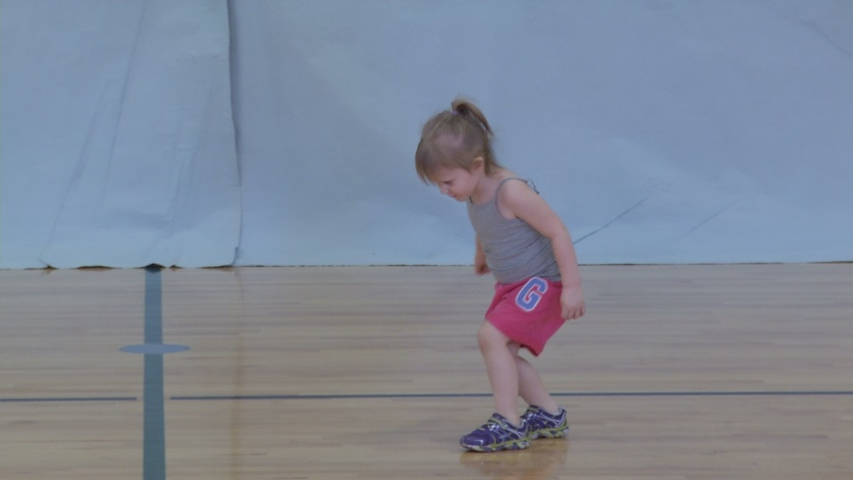
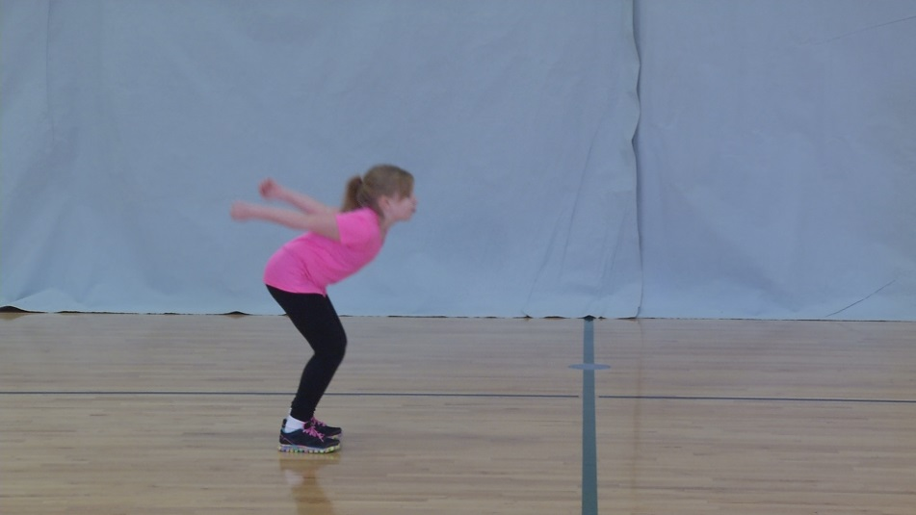
Video 7.7:
Early vs. Proficient Jumping
Click image to view video
Click image to view video

Slide 21
Developmental Changes of Jumping
Continuous growth in body size and strength contribute to quantitative improvements.
It is not guaranteed that every child will eventually master jumping.

Slide 22
Rate Limiters in Jumping
Development of enough force to bring own body into the air from a still position.

Slide 23
Early Hopping
Hopping starts later than jumping.
Early characteristics:
  Support leg is lifted rather than used to project body.
  Arms are inactive.
  Swing leg is held rigidly in front of body.

Slide 24
Proficient Hopping
Swing leg leads hip and moves through full range of motion.
Support leg extends fully at hip.
Oppositional arm movement generates force.
Support leg is flexed on landing.

Slide 25
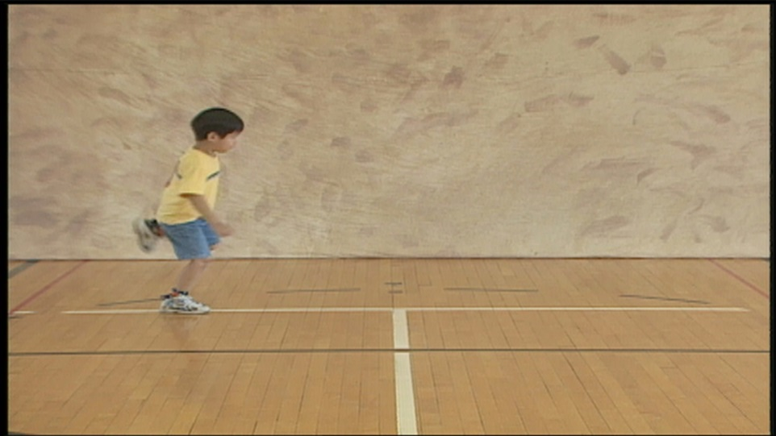
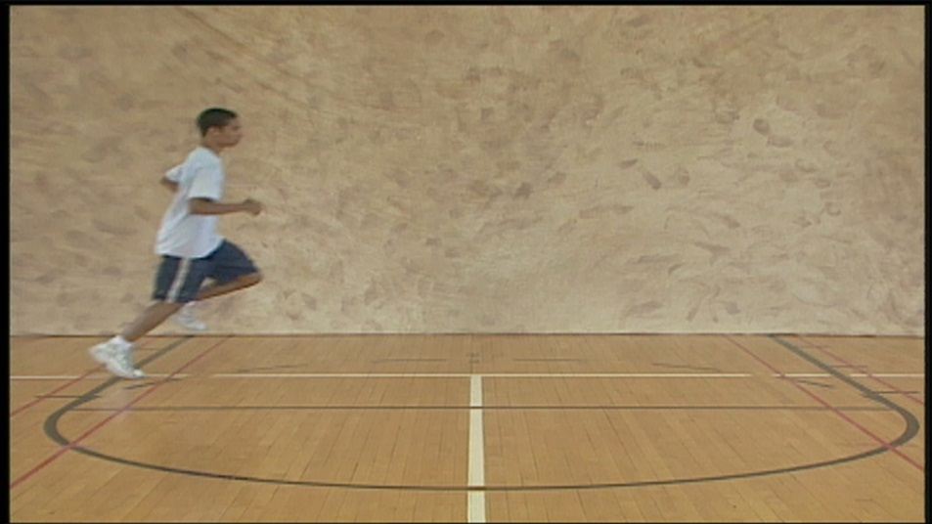
Video 7.8:
Early vs. Proficient Hopping
Click image to view video
Click image to view video
Notes:
Click to add notes

Slide 26
Developmental Changes in Hopping
Few children under 3 can hop repeatedly
Adaptations of the neuromuscular system that moderates the force of landing
Due, at least in part, to an interaction of individual constraints in the body and within the framework of the principles of motion

Slide 27
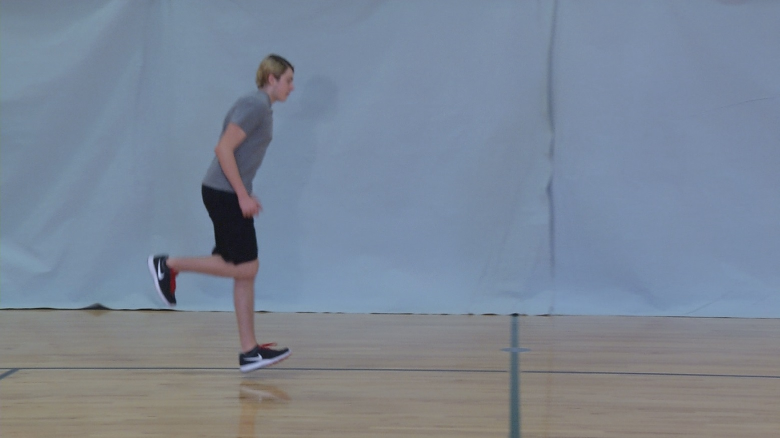
Video 7.9:
Observation of Hopping
Click image to view video
Notes:
Click to add notes

Slide 28
Rate Controllers in Hopping
Depends on the postural system’s ability to balance the body on one limb for a succession of hops
Ability to generate enough force to life the body with one limb, recover, and quickly generate enough force to hop again

Slide 29
Galloping, Sliding, Skipping
Involve combination of skills previously obtained: stepping, hopping, leaping (Roberton & Halverson, 1984; Whitall, 1988).
Gallop and slide are asymmetric.
  Gallop: forward step on one foot, leap on other
  Slide: sideways step on one foot, leap on other
Skip is symmetric: alternating step-hops on one foot, then on the other.

Slide 30
Early Galloping, Sliding, Skipping
Arrhythmic and stiff movements
Little or no arm movement
Little or no trunk rotation
Exaggeration of vertical lift
Short stride or step length

Slide 31
Proficient Galloping, Sliding, Skipping
The arms are no longer needed for balance.
In skipping, the arms swing rhythmically in opposition to the lags and provide momentum.
Child can use the arms for another purpose during galloping and sliding, such as clapping.

Slide 32
Developmental Changes in Galloping, Sliding, Skipping
Galloping is the first to emerge (around 2-3 years of age).
Sliding comes next.
Skipping is usually the last to emerge (around 4-7 years of age).

Slide 33
Rate Limiters for Galloping, Sliding, Skipping
Galloping
Coordination (uncoupling legs)
Differential force production (legs performing different tasks)
Sliding: coordination (turning to one side)
Skipping: coordination (ability to perform two tasks with one leg)

Slide 34
Other Locomotor Skills
Given that humans can move in various ways (e.g., gallop, skip, slide), why is walking most frequently chosen? Discuss in terms of a variety of constraints.

Slide 35
Summary and Synthesis
Transporting ourselves from one place to another is an important part of human life and can be accomplished using many different locomotor skills.
From early childhood through later adulthood, many individual constraints act as rate limiters in the emergence and maintenance of skills.

