Slide 1
Power Point # 2
Part Two
HealthCare Facilities
Based on readings from Barrett, et. al. chapter 22

Slide 2

HOSPITALS IN THE USA
18% are for profit hospitals
23% are specialty hospitals (Will’s Eye, Children’s Hospital, etc.)

Slide 3


Issues
Emergency Rooms and E.R. Directors reporting that there are not enough doctors
on call, especially for specialties such as hand, neuro, ENT, psychiatry
US health care system is very expensive $$$
Presently 46% of health care is funded by the taxpayers in the form of
state, federal, or social security taxes. (black/cash market ?)

Slide 4
Hospital Quality
----------------------------------------------------------------------------------------------------------------------------
Hospitals and Healthcare facilities are accredited by _________
The TJC develops standards of _________& awards ____________
for meeting or exceeding those standards
It includes:
_________-comprised of active physicians who evaluate quality of care at hospitals
2. _________ -which reviews hospital admissions and length of stays.
3. _________- reviews books for defective or unnecessary care
4. _________- reviews surgeries

Slide 5
Discipline of Physicians:
Hospitals may _________hospital treatment privileges
Medical Societies may _________members
States may _________medical licenses to practice in that state.
_________(NPDB)- Gov’t requires certain bodies and
officials to report certain actions against physicians to this data bank.
This is used as a reference in legal, hiring, and insurance matters.
_________(HIPDB)- Same as above but
limited to criminal convictions, civil judgments, malpractice actions, license and
certification actions and exclusion from state/federal healthcare programs.

Slide 6
Consumer Choices
Selecting a Hospital:
Which physicians have admitting privileges to that hospital?
Which healthcare insurance plans cover that hospital?
Ratings: US News and World Report, Consumer’s Checkbook
Types of Senior Living Facilities
_________- low level of service, primarily for independent
Seniors
_________- those that need help with activities of daily living (bath, dress,
grooming, etc.) They coordinate health services, medications, therapy,
transportation, etc. Some have specialized units such as Alzheimer’s, Dementia, etc.

Slide 7
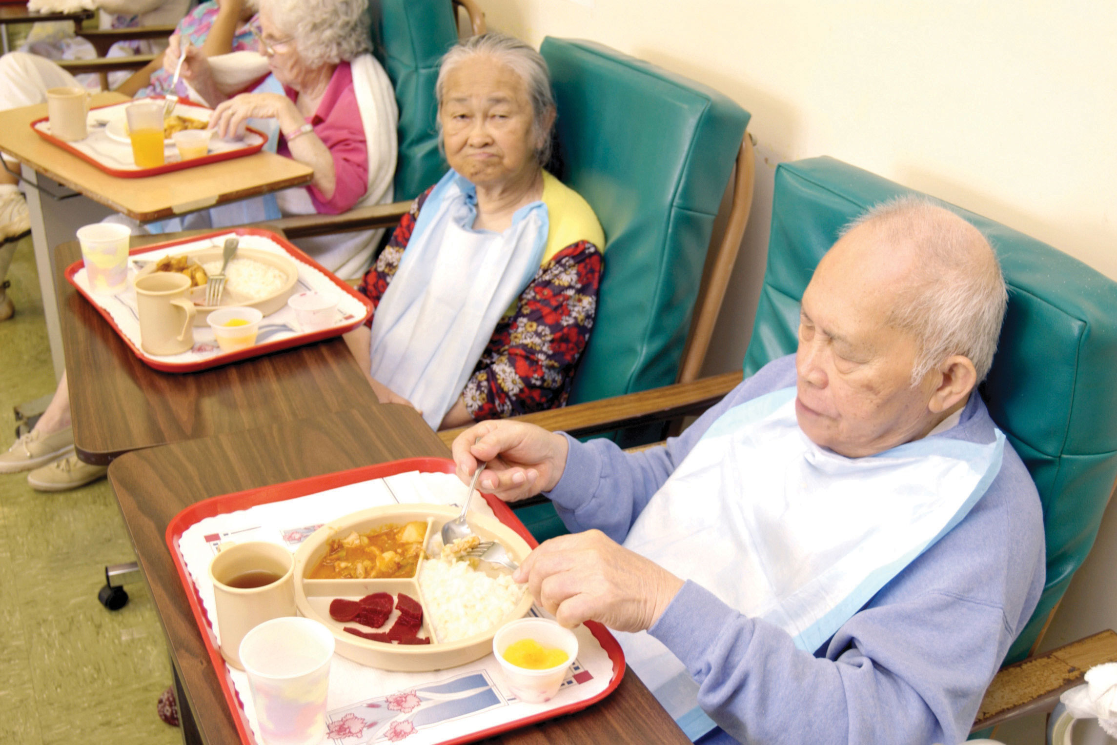
Consumer Choices CONT’D
Nursing Homes/Skilled Nursing Facilities
Have R.N.s, M.D. supervision, custodial care such as bath, toilet, in/out of bed
ISSUES with all of these:
Costs- Assisted living $3,000- $6,000/month, Nursing homes $10,000 + per month
LTC insurance - $$$
Medicare Facilities – Free, Access, Quality?
Always visit before choosing.

