Slide 1
POWEr Point # 2 PART I
Consumer Health
Based on readings from Barrett, et. al. chapters 1, 2, 5, 6, & 7

Slide 2
Cosumer behavior
What influences you to buy a product?
How much time do you spend researching the cost and quality of the product?
What factors affect how much time you put into this research and decision?

Slide 3
Marketing
Put more expensive items at eye level (easily seen)
Make items look more appealing (lighting, moisture on produce, attractive arrangements, etc.)
Store Shuffle- to force you to view new items and sections of the store
Confusing pricing- by the ounce, two fors, BOGOs

Slide 4
Intelligent consumer behavior
Be skeptical and demand evidence
Understand the logic of science and scientific verification of truth (scientific method)
Seek reliable information (websites) Mayo Clinic, NCCIH, Healthfinder, MedlinePlus.gov, InteliHealth.com (Harvard Medical School), .gov, .edu Research and review medical practitioners, treatments, and diagnostic tests
Intelligent use of the Internet:
Have you been scammed?
“https”
Never use Debit Cards
Return Policies

Slide 5
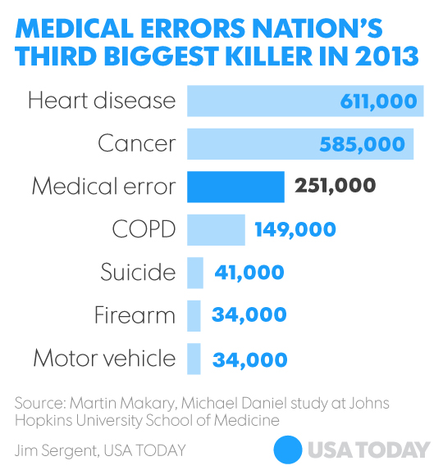
Health Care
Be involved in your health care – ask questions
Medication errors ----------------------------→
75,000 deaths per year from hospital acquired infections (CDC, 2015)
648,000 people develop hospital acquired infections per year during their stay (CDC, 2015)

Slide 6
ERRORS in healthcare
Surgical errors, incorrect diagnosis, etc.
Dental Errors:
Estimated
1.5
MILLION
injuries from
prescription
drug errors

Slide 7
CHOOsing a Doctor
Healthcare Professionals- most regulated by state licensing laws and accrediting bodies
Medical Doctors (M.D.)
Four year degree
MCATs test (Medical College Admission Test)
Four more years of study at an accredited Medical School (college or university). Graduate and pass a national board examination to be licensed in your state.
All states required at least three years of training at a hospital (residency) in a specialty (3-7 yrs. depending on the specialty)
Refer to pages 20-21

Slide 8
Choosing a Doctor CONT’D
5. Pass USMLE (United Stated Medical Licensing Exam)- Consists of 3 parts, taken over several years during one’s residency. Must pass all parts.
6. Fellowship – 6 mos. to 3 years depending on the specialty. Not all MDs must do a fellowship. Required for Cardiology, Gastroenterology, etc.
7. Get state license
8. Pass a specialty exam
9. Obtain hospital affiliation/privileges.

Slide 9
Doctor of Osteopathy (D.O.) – Identical to M.D. (legal equivalent with a slight additional emphasis on the musculoskeletal system. There used to be a larger difference.
Board Certified- by the American Board of Medical Specialties (ABMS). Requires high standards of training and performance. They met these standards and passed an examination. Renewed every 7-10 years. They must again meet the standards and pass the exam. “Board eligible” means they didn’t take the exam yet.

Slide 10
CHOOSING A DOCTOR
Fellow of the American College of Surgeons?
Board Certified plus 1 year of community practice
Undergo a peer review of ethics, personality, and first hand observations of competence in the O.R.

Slide 11
Mental health professionals
Psychiatrists- MDs or DOs with specialty in psychiatry
Psychologist – Ph.D. or Psy. D. plus supervised clinical experience, pass an exam
Psychoanalyst- most are the above but the title is not regulated by law and can be used by ANYONE
Certified clinical mental health counselors- Master or Ph. D. plus clinical experience, pass written exam
Treatments- cognitive, behavioral, group, hypnosis, drug, psychotherapy, ECT or EST (video)
Most common? Most effective?

