Slide 1
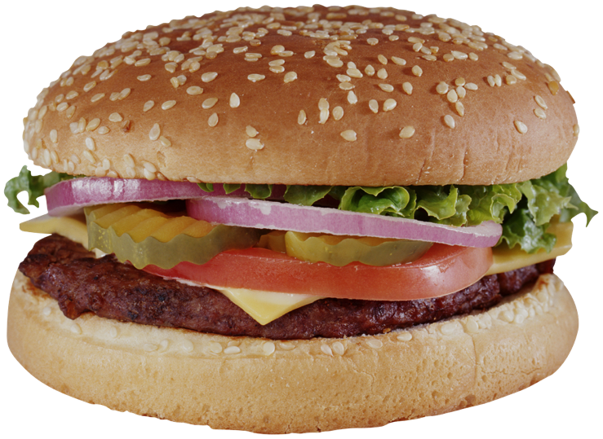
PowerPoint #8
Weight Management
Based on readings from Barrett, et. al. chapters 10, 11 & 12

Slide 2
Chapter Objectives
Describe the epidemic of overweight and obesity in the United States.
Describe the human and financial costs of obesity.
Explain the Body Mass Index.
Explain the standard recommendations for weight control.
Explain the role of physical activity in weight management.
Compare and contrast diets.

Slide 3
Chapter Objectives
State the nature, design, and effects of restricted carbohydrate diets.
List several over-the-counter weight reduction products and their ingredients.
Explain how prescription weight loss medications work.
Discuss fad diets.
Explain the types of bariatric surgery.

Slide 4
America’s Weight Problem
Overweight and obesity are at epidemic proportions.
They are related to many serious _________.
About two-thirds of Americans are __________ or ________.
About ______ percent of infants and toddlers carry too much weight.
The percentage of overweight children and adolescents has quadrupled since the early 1970s.
Overweight and obesity cause increased costs in the health care system.
Americans Spent ~ $61 billion on products & services related to weight control (2010)

Slide 5
Facts
The keys to weight management are healthy eating and physical activity.
____________ of obesity is more prudent than later weight reduction.
_________ alone is seldom successful at weight loss in the long-term.

Slide 6
Standards & Recommendations
Balance calorie intake with calorie expenditure.
Each pound of fat contains 3500 calories.
_________ caloric intake coupled with ________ caloric use through physical activity, is the key to weight loss.
_________ commitment is crucial.

Slide 7
The Role of Physical Activity
Physical activity burns calories.
Regular physical activity increases the _______metabolic rate, resulting in burning more calories at _______.
Physical activity is a key to ____ _____weight loss and weight management.

Slide 8
Mediterranean Diet
Appears to reduce risk of obesity and heart disease
Common elements
Fruits and vegetables
Bread and other cereals
Potatoes, beans, nuts, and seeds
Olive oil
Dairy products, fish, and poultry in small to moderate amounts; little red meat
Eggs zero to four times a week
Wine in small to moderate amounts

Slide 9
Diet Plans
Perricone – obesity is caused by inflammation
Eat brightly colored foods- fruits/vegetables
Avoid inflammatory foods – sweets, sugars
eDiets.com-
online community featuring Nutritionists
a large database, offers personalized diet plans

Slide 10
Very-Low-Calorie Diets
Provide fewer than 800 calories per day
Usually used only under medical supervision, including a physician, psychologist, dietician, and exercise physiologist.
Serious complications, including death, have been reported when applying a VLCD in the absence of medical supervision.
Often result in loss of lean body mass.
Benefit is mostly short-term.

Slide 11
Low-Calorie Diets
Provide 800 to 1500 calories per day
Can be beneficial to most overweight people
Medical consultation, but not necessarily supervision, is recommended.
Success depends on selection of healthy foods and commitment to physical activity.

Slide 12
Commercial Weight Loss Programs
Long-term study of commercial programs is not usually done.
They vary greatly in cost.
Federal regulation is mostly related to advertising.
If considering a commercial program:
Ask about the qualifications of the staff.
Ask whether counseling is available.
Investigate scheduling of meetings and consultations.
Talk with your physician.
Attempt to find research about the long-term results of the program.
Ask about the costs.

Slide 13
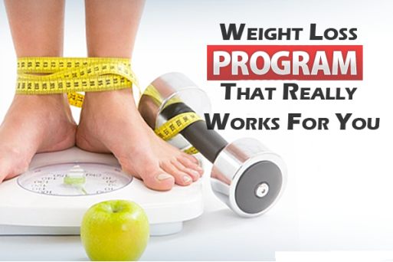
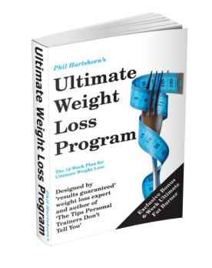
Commercial Programs
Examples of popular programs
Have you tried any?
Dubious Products/Treatments: Eat according to your blood type, grapefruit diet, cookie diet, body wrapping, spot reducing, make-me rich diet (doesn’t work for you, works for me $$$ ☺)

Slide 14
Organized Self-Help Programs
Cost may be very low or free.
Based on empathy and mutual support
Examples:
Take Off Pounds Sensibly (TOPS)
Overeaters Anonymous

Slide 15
Carbohydrate Restricted Diets
May be low-carbohydrate or very-low-carbohydrate
Often result in rapid weight loss without counting calories
Long-term usefulness and safety is not fully known.
Some recommend or require purchase of their meals.
Examples:
The Atkins Diet
The South Beach Diet

Slide 16
Possible Negative Effects of Restricted Carb Diets
Headaches, muscle weakness, and diarrhea or constipation
Electrolyte imbalance caused by rapid weight loss
Dangerous effects when taking some medications
Renal decline in women
Increased fats, cholesterol, and triglycerides in the blood
Shortage of dietary fiber
Kidney damage

Slide 17
Diet Pills and Drinks
Nonprescription products have been mostly ineffective.
Liquid diets may result in loss of lean body mass and cause electrolyte imbalance.
Use of these products does not establish healthy lifestyle habits.

Slide 18
Examples of Weight Loss Products
Nonprescription
Alli or Orlistat (FDA approved)
Ephedra and ephedrine
Caffeine
Slim Fast
Phenylpropanolamine-PPA-once popular in OTC diet pills, FDA 2005-not safe- increases risk of hemorrhagic stroke (brain bleed). Can get from other countries via net.
Prescription
Xenical or Orlistat-reduces absorption of fat
Meridia- suppresses appetite

Slide 19
Fad Diets
Definition: a diet that has little or no nutritional value or scientific credibility and that usually has short-term popularity.
Often supported by extravagant promises and money back guarantees.
Many concentrate on one food.
Because of their short-term popularity, there is virtually no research on their risks and benefits.

Slide 20
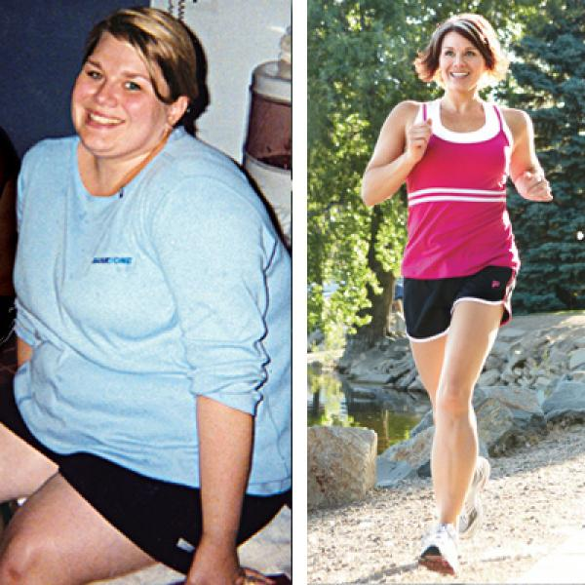
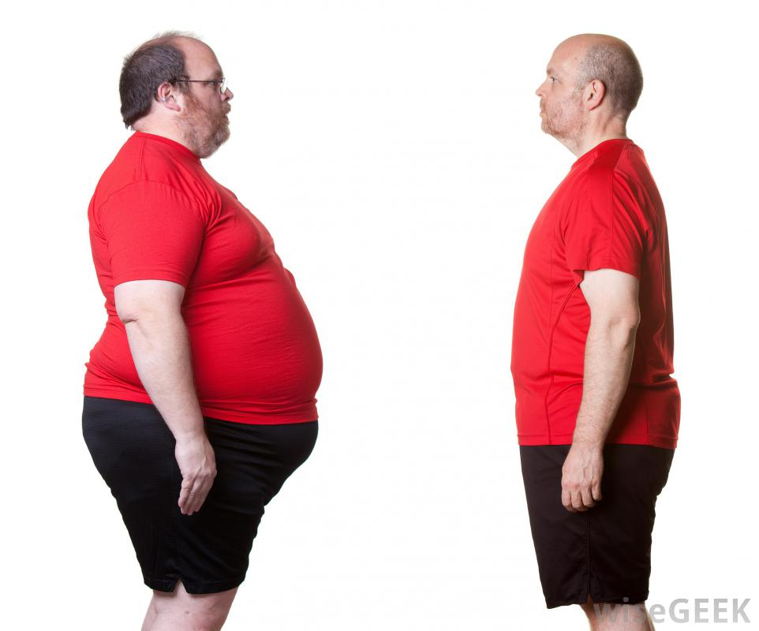
Do Diet Programs Work?
There is insufficient evidence to support the use of most major commercial and self-help programs.
Many produce short-term weight loss but fail in the long-term.
A moment in time or a permanent change?

Slide 21
Bariatric Surgery
Usually reserved for men who are _____ pounds over their desired weight and women who are ____ pounds over their desired weigh, or those with BMIs of ___ or higher
General types:
Restrictive procedures*
Malabsorptive procedures*
http://www.youtube.com/watch?v=lTlVIcWg4gw
http://www.youtube.com/watch?v=_tMa8Aaaj_Y

