Slide 1
Psychosocial Constraints in Motor Development
Chapter 16

Slide 2
Psychosocial Influences
Interaction of individual (functional) constraints with environmental (sociocultural) constraints
Emotions, perceived ability, and other personal attributes

Slide 3
Self-Esteem
Self-evaluation of individual capability
General
Specific (physical ability, appearance, social skills)
Person’s belief in correctness of self-evaluation more important than accuracy of self-evaluation (Weiss, 1993)
Specific domains (social, academic, physical)

Slide 4
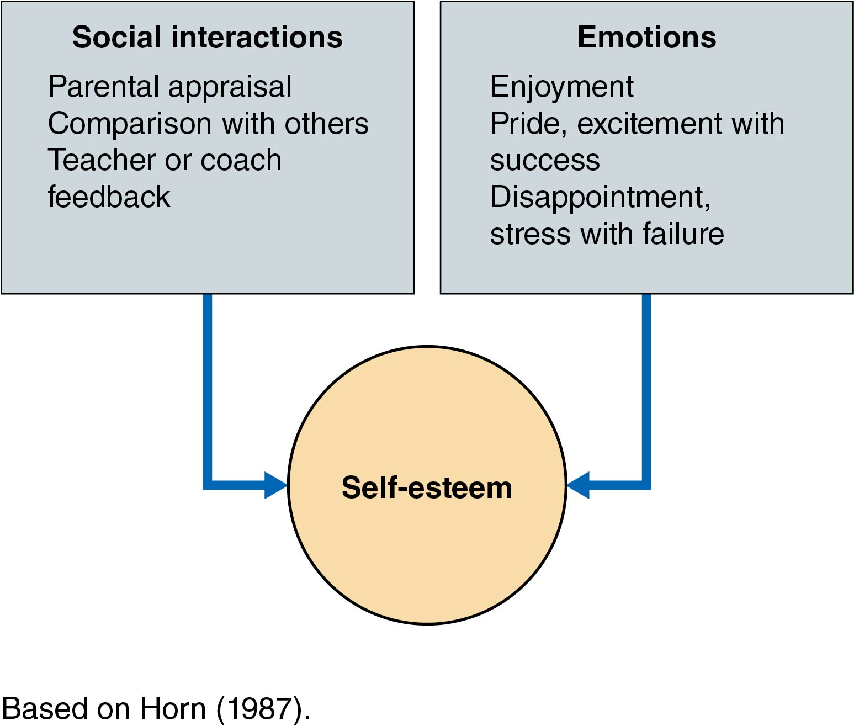
Figure 16.1: Self-Esteem

Slide 5
Development of Self-Esteem
Children under 10 depend on appraisals of and comparisons with peers to determine physical competence. (Horn & Hasbrook, 1986; Horn & Weiss, 1991)
Children of all ages develop self-esteem from feedback and appraisals from teachers and coaches. (Smoll & Smith, 1989)

Slide 6
Question
How can self-esteem act as a constraint in the following?
Young child
Professional athlete
Notes:
Click to add notes.

Slide 7
Social Interactions
Comparison to peer performance can begin as young as 5 years of age.
Young children are not as accurate as adolescents in their self-evaluations.
Feedback and appraisal from teachers and coaches can also influence self-esteem.

Slide 8
Emotions
Emotions associated with participation in sport and physical activity affect self-esteem development.
Enjoyment in pre- and young adolescents is furthered by perceptions of high ability, mastery, low parental pressure, and greater parent and coach satisfaction. (Brustad, 1988; Scanlan & Lewthwaite, 1986; Scanlan, Stein, & Ravizza, 1988)

Slide 9
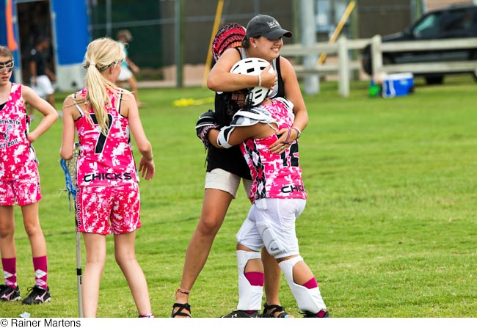
Figure 16.2: Feedback Contributes to Self-Esteem

Slide 10
Causal Attributions
Causal attributions are the reasons people give for their successes and failures.
People tend to act in ways that confirm their beliefs.
(continued)

Slide 11
Causal Attributions (continued)
A person with high self-esteem makes the following causal attributions:
Internal: The person is responsible for his or her own success or failure.
Stable: The outcome-influencing factors are consistent from one situation to the next.
Controllable: The person is in control of the outcome-influencing factors.
(continued)

Slide 12
Causal Attributions (continued)
A person with low self-esteem makes the following causal attributions:
External: Success and failure are due to influences outside the person.
Unstable: The outcome is based on fluctuating influences (e.g., luck).
Uncontrollable: The person is unable to control or influence the outcome.

Slide 13
Children’s Attributions
Children with high self-esteem give internal, stable, controllable reasons for outcomes.
Children with low self-esteem tend to make inaccurate attributions about outcomes and exhibit the following behaviors:
Unwillingness to try challenging tasks
Lack of effort to do well
Avoidance of participation

Slide 14
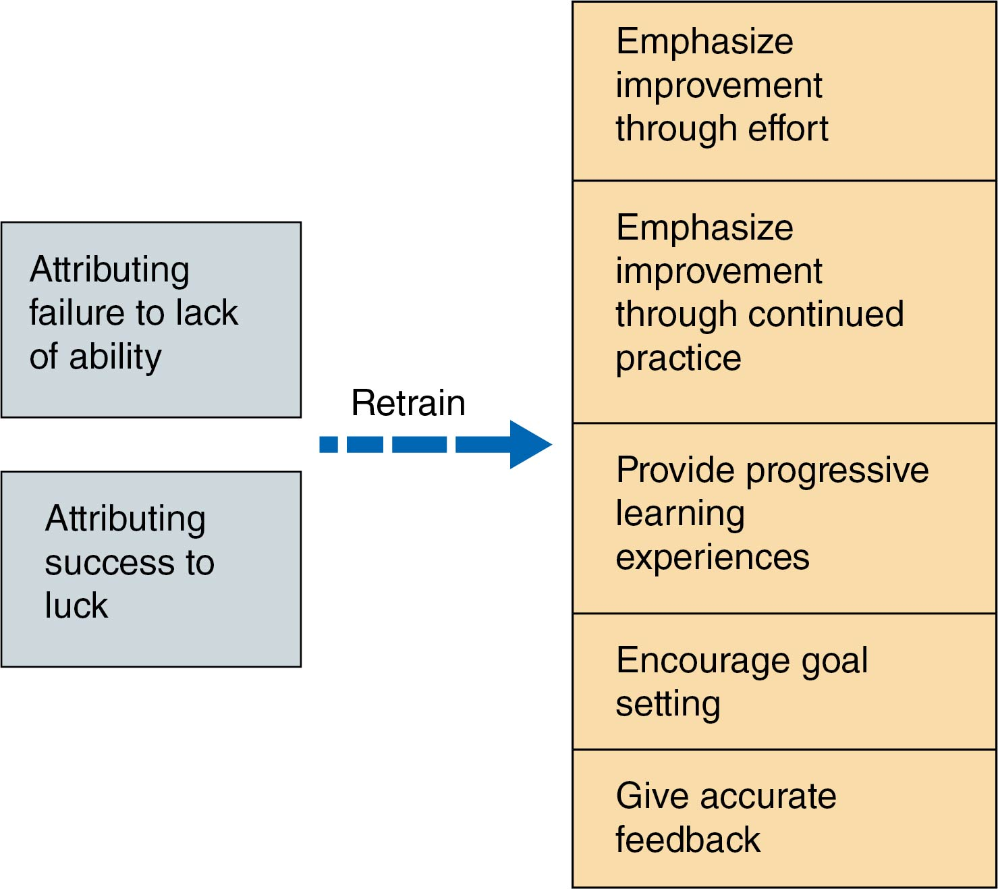
Figure 16.3: Retraining Can Change Causal Attributions

Slide 15
Adults’ Attributions
Adults evaluate themselves in these ways:
Observing past and present accomplishments and failures
Comparing themselves with others
Receiving verbal persuasion from others
Observing their physiological state or fitness level
Notes:
Click to add notes

Slide 16
Question
How can causal attributions act as a constraint on motor development in the following?
High school female learning basketball
All-star Little League pitcher

Slide 17
Perceived vs. Actual Motor Competency
Perceived motor competence is a source of behaviors such as participation in physical activity.
High perceived competence can result in the following:
Higher self-esteem
Increased performance effort
Increased engagement

Slide 18
Developmental Relationships
Early childhood
Perception of actual motor ability is inaccurate.
Giving effort is equated to high levels of competence.
Moderate positive relationship seen between perceived and actual motor competence.
(continued)

Slide 19
Developmental Relationships (continued)
Middle childhood
Perception improves.
Boys perceive their motor competence to be higher.
Girls perceive their locomotor skills to be less than they are.
Boys perceive their object control skills to be higher than they are.
(continued)

Slide 20
Developmental Relationships (continued)
Adolescence
De Meester et al. (2016) found four clusters:
Low perception, accurate judge of competence
Low perception, overestimated competence
Average perception, accurate judge of competence
Average perception, overestimated competence
Increasing research support saying perceived motor competence mediates the relationship between actual motor competence and level of physical activity

Slide 21
Measuring Self-Esteem in Children
Harter’s Self-Perception Profile for Children
36 statements for five domains (scholastic competence, athletic competence, social acceptance, physical appearance and behavioral conduct)
Global score for self-worth
Age 8 years through adolescence
Pictorial scale for children under 8 years

Slide 22
Motivation to Participate
Self-esteem and motivation to participate are related in both children and adults.
High motivation level is essential for beginning or maintaining participation in sports and physical activities.
Persistence is continued engagement in physical activity and sport.
Dropping out and discontinuing engagement in physical activity and sport can occur by controllable or uncontrollable factors.

Slide 23
Children’s Reasons for Persistence
Children have a desire to
be competent by improving skills or attaining goals,
affiliate with or make new friends,
be part of a team,
undertake competition and be successful,
have fun, and
improve fitness. (Weiss, 1993)

Slide 24
Children’s Reasons for Dropping Out
Dislike of coach
Lack of playing time
Too much pressure
Too much time required
Overemphasis on winning
Lack of fun
Lack of progress
Lack of success

Slide 25
Question
A recent review by Crane and Temple (2015) concluded the major reasons for youth dropout from physical activities are lack of enjoyment, perceptions of physical competence, social pressures, competing priorities, and physical factors (such as injury). If you were in charge of a youth sport program, what would you do to improve retention rates in your program, given these five reasons?

Slide 26
Teacher-Centered vs. Student-Centered Approaches
Teacher-centered approach
Instructor designs and presents developmentally appropriate activities in class.
Instructor chooses when to progress students to the next task.
Student-centered approach
Student has optimal control over engagement-related decisions.
Student effort is recognized as connected to the outcome.
Mastery motivational climates favorably influence young children’s fundamental motor skills and activity level.

Slide 27
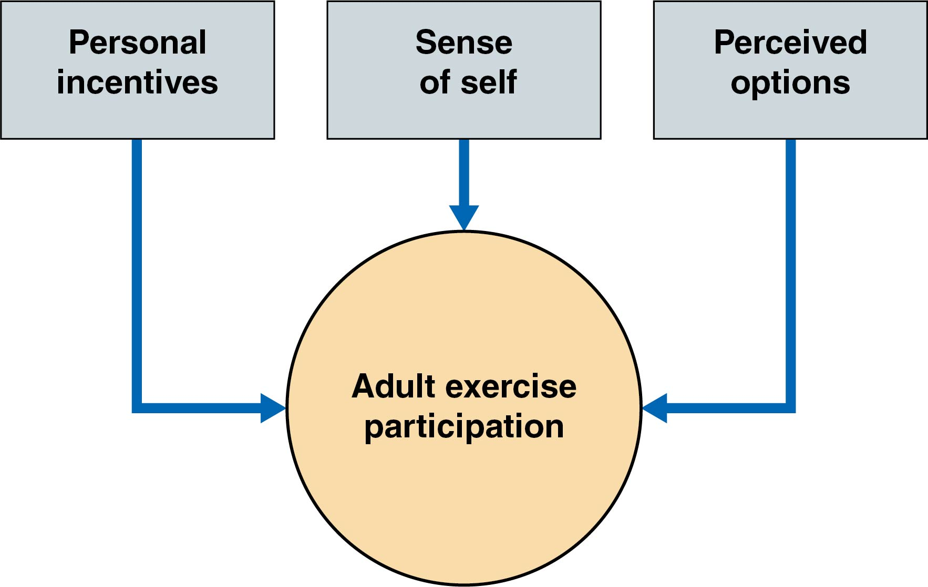
Figure 16.5: Adult Activity Levels

Slide 28
Adult Activity Levels
Duda & Tappe (1988, 1989a, 1989b) proposed that adult exercise participation reflects three interrelated factors:
Personal incentives, such as a desire to demonstrate mastery, compete, be with others, receive recognition, maintain health, cope with stress, or improve physical fitness
A sense of self, particularly in regard to one’s self-esteem for physical activity
Perceived options, or the opportunities a person has in a given situation, such as transportation to various sites where adult programs are offered
Notes:
NEW EDIT

Slide 29
Adult Participation
Adult participation levels may be limited by these factors (McPherson, 1986):
Stereotypes of appropriate activity levels
Limited access to facilities and programs
Childhood experiences
Concerns over personal limitations on exercise
Belief that exercise is harmful to health
Lack of role models
Lack of knowledge about appropriate exercise programs
Notes:
Click to add notes

Slide 30
Summary and Synthesis
Physical activity has been proven beneficial at all ages.
Perceived competence is a mediator between actual motor competence and physical activity level.
Participation in physical activity reflects motivation to participate.
Motivated people at all ages tend to have higher levels of self-esteem.
Self-esteem can be improved through efforts of peers, teachers, coaches, and significant others.

