Slide 1
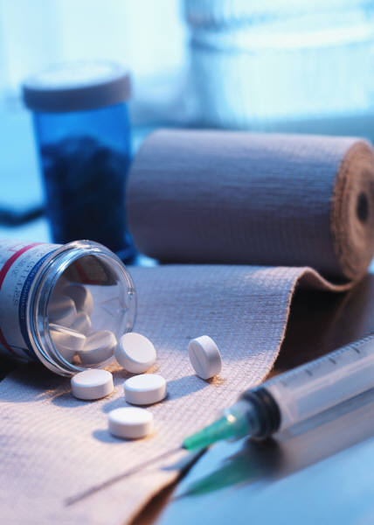
Medications
PPT. # 5
Based on Barrett, et. al. chapter 17

Slide 2
Statistics
The top 10 medications in 2015 by number of monthly prescriptions are:
Synthroid (levothyroxine), 21.5 million –treats hypothyroid
Crestor (rosuvastatin), 21.4 million -treats high cholesterol
Ventolin HFA (albuterol), 18.2 million –asthma/breathing problems
Nexium (esomeprazole), 15.2 million-stomach acid/heartburn
Advair Diskus (fluticasone), 13.7 million- asthma/COPD/breathing problems
Illicit Drugs (2010) $100 billion (Cocaine, heroin, pot, meth.) – (Rand Corp.)
Prescription Drugs (2016) - $323 billion (QuintilesIMS)
Projected Prescription Drug Market, 2021-$ 405 billion!
Total Drug Expenditures by US population?

Slide 3
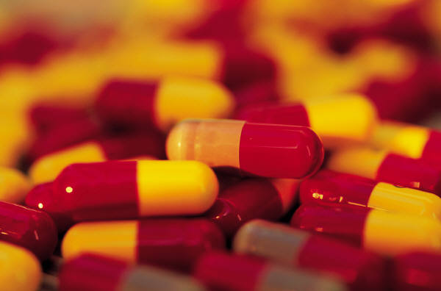
CONCERNS
Drug Interactions- w/ other drugs, alcohol, herbs and supplements
Drug recalls- www.recalls.gov ~12 since 1997
Adverse Drug Events
Injuries resulting from medical intervention related to a drug. This includes medication errors, adverse drug reactions, allergic reactions, and overdoses:
Account for an estimated 1 in 3 of all hospital adverse events
Affect about 2 million hospital stays each year
Prolong hospital stays by 1.7 to 4.6 days
Over 3.5 million physician office visits
An estimated 1 million emergency department visits
Approximately 125,000 hospital admissions (health.gov)
Fatal Drug Events – (2005): ~ 15,000 (Arch Intern Med. 2007;167(16) 1752-1759
This doesn’t not include overdose – 183,000 deaths from 1999-2015 from opioid OD. (CDC).
Drug Approval Process
High Cost to Approve and Manufacture Drugs

Slide 4
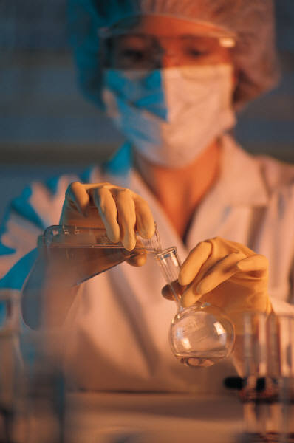
Generic Drugs
Patent expires after 20 years, then other companies can manufacture it and it is under its chemical name.
Less expensive as there is no research cost
FDA standards are the same for brand name & generics

Slide 5
Generics
Contain essentially identical amts. of identical ingredients in identical doses (__________ equivalence)
Must perfom in the same manner as the name brand (______equivalence)
Must deliver the same amt. of active ingredient into the bloodstream as the name brand (______availability)
Generics do not undergo extensive testing & clinical trials

Slide 6
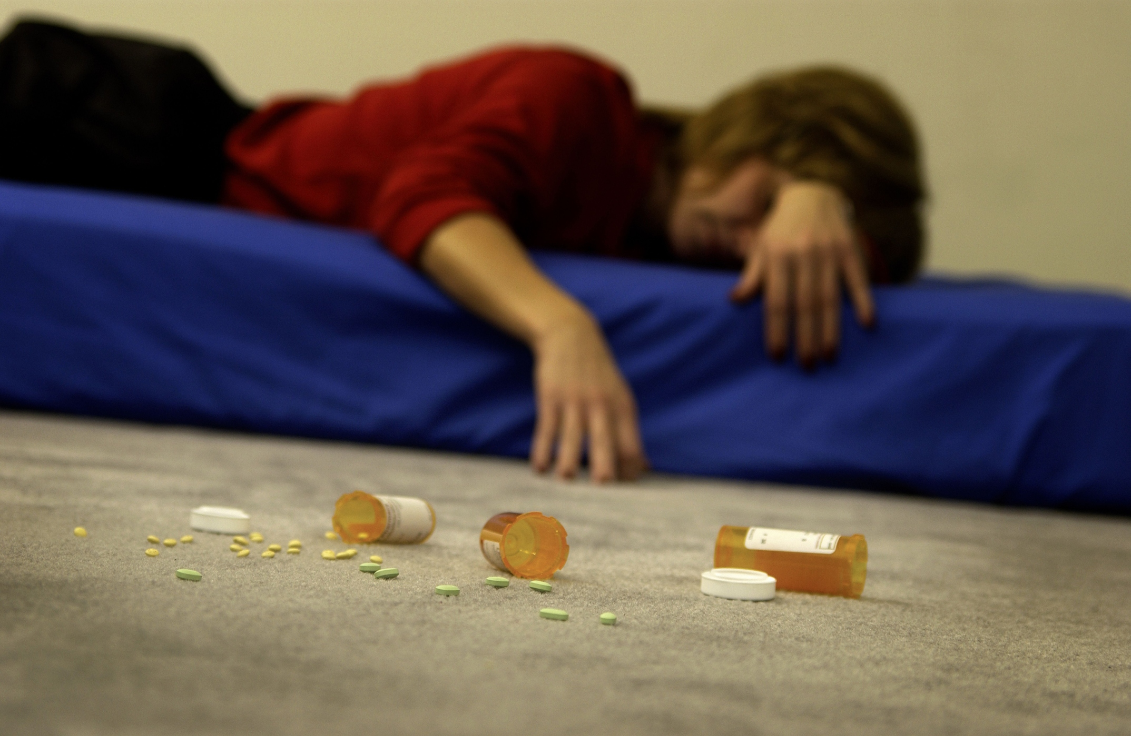
Presecription Drug Abuse
After marijuana and hash (36%), amphetamines (6.7%) like Ritalin or Adderall account for most of the top drugs abused by 12th graders in the past year, according to the National Institute of Health (NIH) 2016
In the US alone, more than 15 million people abuse prescription drugs. Source: Foundation for a Drug-Free World (2015)
52 million Americans over the age of 12 have used prescription drugs non-medically in their lifetime. Source: National Institute on Drug Abuse (2015)
Most abused prescription drugs fall under 3 categories: painkillers – 5.1 million; tranquilizers/depressants – 2.2 million; stimulants – 1.1 million. Source: National Institute on Drug Abuse (2015)
54.2% of prescription drug users get them free from a friend or relative. Source: National Institute on Drug Abuse (2015)

Slide 7
Internet Prescriptions –Most popularl usually Propecia (hair growth) and Viagra
Many require no scripts
VIPPS
1/5 of internet pharmacies were under investigation (68 internet pharmacies/2004)
Canadian Pharmacies –safe, lower $$, require Rx, banned but no one has been prosecuted for personal use
Counterfeit Drugs- est. $75 billion market

Slide 8
Orphan Drugs
Drugs that treat _______ diseases
6,000 conditions that affect less than 200K citizens
Cost is too _______for such a small market (no profit)
____________________of 1983 offers incentives & tax credits, 7 year monopoly and research grants to encourage drug companies to develop these drugs
1983-2010, 347 new drugs developed and reached the market (MS, CF, hemophilia, etc)

Slide 9
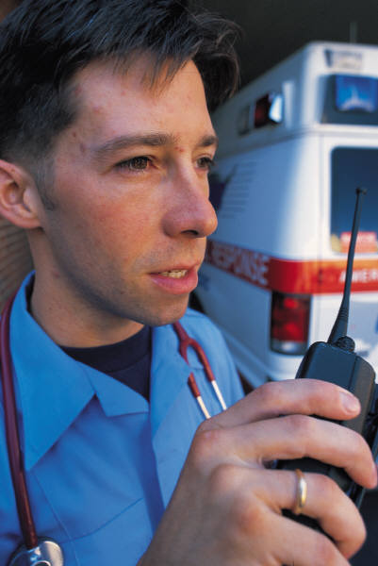
OTC Drugs
Over $17 Billion spent annually
No Script
Self-Directed
Self Diagnosed
Non-habit forming
300K OTC products w/1500 active ingredients
~ 200,000 Hospitalizations due to misuse of OTC drugs. WHY?
(Read the label)
Interactions with alcohol or other prescription or OTC drugs

Slide 10
Common Pain Relievers
Acetaminophen- overuse =________damage
Alcohol use increases risk of _______ damage
NSAID (Ibuprofen)
Increase risk of _______________especially if over 60 on blood thinners, ulcers, or other bleeding issues.
Can damage __________
Above safe if used correctly and sparingly
Methamphetamine Production-
Pseuoephedrine used in above. 2006 law requires ID and limits purchase.
BTC_____ ___ _______ designation added to some OTC drugs in Canada and now the USA

