Slide 1
Consumer Health Decisions
Complementary & Alternative Medicine
PPT # 6
Based on Barrett, et. al. readings chapters 8 & 9

Slide 2
Topic Objectives
Distinguish among conventional medicine, complementary therapies, and alternative therapies.
Explain integrative therapy.
Explain the five categories of complementary and alternative medicine.
Discuss the reasons for the popularity of complementary and alternative medicine and the characteristics of people most likely to use them.
Explain the tenets supporting several complementary and alternative therapies.
List the information needed to decide on using a complementary or alternative therapy and identify sources of that information.

Slide 3
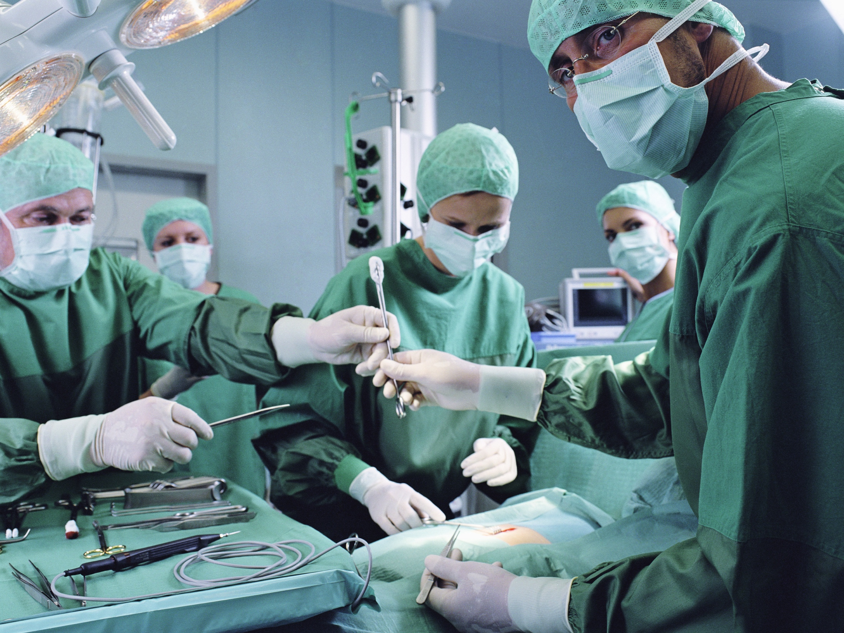
Conventional Medicine
That which has undergone extensive _______in _______ trials and has been shown to exceed some agreed upon standards of _______ and _______.
Also called _______ or allopathic medicine.

Slide 4
Definitions
_______ therapy: a remedy that has not been shown by scientific study to be safe and effective but is used in place of conventional (allopathic) medicine.
_______ therapy: a therapy that has not been accepted as conventional medicine but is used together with conventional(allopathic) medicine.

Slide 5
CAM Philosophies
Facilitate the body to _______ itself: i.e. boost the _______ system. This is better then antibiotics
Emphasize _______(boost immune system, stress relief & management, spiritual congruence, etc.)
Patient _______ themselves, the practitioner guides them (responsibility shifts to patient)

Slide 6
Background/History
Before Mod. Med. the sick turned to folk medicine, shamans (witch doctors, mediums, etc.)
Put a penny on a wart then bury it, chants, herbs, rituals, etc.
1800s science based medicine took root & began to grow, licensing and medical schools were established.
Folk practitioners were not licensed thus competition between the two approaches developed

Slide 7
Background/history
Allopathic docs. saw folk docs as hucksters, scammers who were taking advantage of the sick and desperate.
1970s- CAM became popular again as health care costs increased & service decreased
Today some complementary practices are recommended by doctors and proven to be advantageous by science. This is especially true in areas such as _______, _______, and _______

Slide 8
Background
1998 NIH founded the National Center for Complementary and Alternative (Now Integrative) Medicine which supports research in these areas
7500 trials in 2008
As research supports a CAM treatment it leaves the category and becomes “_______” medicince. (e.g. fish oil supplements to treat heart disease).

Slide 9
Categories of CAM
_______ built on systems e.g. traditional Chinese Medicine, Ayurveda (traditional medicine of India). Centers around a philosophy/lifestyle
_______ to enhance the mind’s capacity to affect bodily function & symptoms, e.g. meditation, prayers, yoga, biofeedback, mental healing, etc.
_______ based therapies- Use of natural substances-herbs, foods, vitamins (e.g. shark cartilage to treat cancer)
_______ and body-based methods-based on manipulation of a body-part e.g. chiropractic, massage, reflexology, etc.
_______ therapies-Bio-field- pressure touch by hands relieves improves flow e.g. Reiki, Therapeutic Touch, electromagnetic therapies

Slide 10
Popularity of CAM in the U.S.
National Health Interview Survey 2007:
$33.9 billion spent on CAM practitioners, products, nad services
38 million adults made and estimated 354 visits to CAM practitioners
Most common: Non-vitamin, non mineral natural products (herbal teas, supplements, etc.), meditation, chiropractic manipulation, massage and yoga.
.

Slide 11
Homeopathy
Law of Similars: if a large amount of a substance causes certain symptoms in a healthy person, smaller amounts of the same substance can treat those symptoms in an ill person.
Law of Infinitesimals: a substance’s strength and effectiveness increases the more it is diluted.
_______ remedy: the belief that one remedy would cure all symptoms; now mostly rejected by homeopathists.
Chronic diseases are simply manifestations of a suppressed itch or psora; now abandoned.

Slide 12
Regulation of Homeopathic Remedies
Regulated by the FDA in similar manner as nonprescription drugs.
Manufacturers are excused from submitting new drug applications to the FDA.
Products are exempt from some good manufacturing practice requirements.
If they are claimed to cure a serious disease, they may only be sold by prescription.
Regulation and licensing among the states is inconsistent.
Only three states license medical doctors to practice homeopathy.

Slide 13
Naturopathy
Also referred to as “natural medicine” used to “assist nature” to promote the body’s natural healing processes.
Emphasize prevention
Utilizes processes and products to rid the body of waste products and toxins.
Methods include fasting, natural foods, vitamins, herbs, massage, exercise, colon irrigation, natural childbirth, etc.
Proponents: it combines traditional therapies with some modern medicine practices (used radiation for diagnostics but not treatments).
Critics: it is largely pseudoscientific and fails to meet _______ of scientific evidence of effectiveness and safety.

Slide 14
Naturopathy
Based on vitalism, or “life force” an energy or characteristic of the body to live and function at a high level. This is distinct from forces and processes explained by physics and chemistry.
Science contradicts vitalism.
Not covered by Medicare or most health insurance policies
Doctor of Naturopathy degree:
Four year degree with prerequisite science courses included, then four years at a Naturopathic university which includes two years of clinical experience.
Licensed and legally practice in 16 states, mostly in the west.

Slide 15
Ayurveda – Traditional in India
“Validated” by observation, inquiry, direct examination, and ancient _______ rather than science.
More of a way of _______ than a treatment.
Uses a “constitution model” that provides guidance regarding food and lifestyle.
Views a human as made up of _______ primary elements: ether, air, fire, water, and earth.
The combination of these elements makes individuals unique.
Three “doshas” hold primary influence – vata, pitta, and kapha.

Slide 16
Ayurveda
There is no state or national licensing.
There is no governmental regulation in the U.S.
Standards of competency are set by individual schools.

Slide 17
Reiki – Traditional in Japan
A system of _______ energy to someone for healing.
Adherents believe that Reiki directs the energy that makes up the universe to the people, places, and things where there is a difference between the current form and the ideal form.
In one form, Reiki energy flows from the practitioner’s hands to the patient, treating health problems and improving mental clarity, well-being, and spirituality.

Slide 18
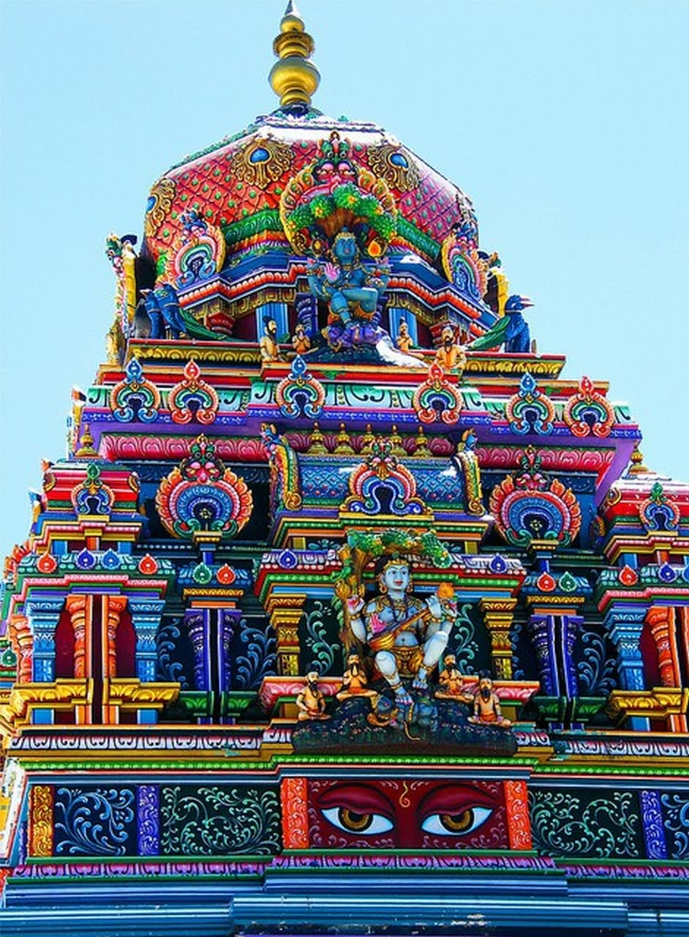
Yoga
Exploration of the eight limbs of yoga refines behavior in the outer world and allows us to focus inwardly.
There are six branches of yoga: hatha (the physical), raja (meditation), karma (service), bhakti (devotion), jnana (the mind; wisdom), and tantra (sexuality)
In the West, many people use it for _______, _______ relief, and _______.
Often used as a complementary therapy

Slide 19
Chiropractic additional info in chapter 9
Primary concept: a properly functioning _______ system is the key to health.
Emphasizes the _______ and nerves.
The primary technique is spinal manipulation.
Some chiropractors claim to treat conditions not associated with the spine.
Practitioners often discourage use of medications.
Some chiropractors use other alternative practices such as herbal and reflexology.
Some practitioners refer patients to physicians.
Some physicians refer patients to chiropractors.

Slide 20
Regulation of Chiropractic
Licensed and regulated in every state
Colleges of chiropractic are regulated through the process of accreditation.
Usually covered by insurance to treat certain conditions for a limited number of visits

Slide 21
Acupuncture – Traditional in China
Based on the belief that the vital force chi regulates spiritual, emotional, mental, and physical balance.
Chi is influenced by opposing forces, _______ and _______
Acupuncture is said to keep the normal flow of chi clear and unblocked, balancing yin and yang.
Energy flows through _______ in the body.
Acupuncture points along the meridians are stimulated with needles, manual pressure, electricity, or other means.

Slide 22
Acupuncture
There is __correlation between meridians and actual position of organs and nerves.
Most often used for pain relief in the West.
Mainly used as complementary therapy in the U.S.

Slide 23
Regulation of Acupuncture
Over 30 states have specific laws regarding acupuncture, including licensing and certification.
FDA has approved acupuncture needles for use by licensed practitioners.
In states that do not recognize acupuncturists, they may practice under the supervision of a licensed physician.

Slide 24
Reflexology
The parts of the body coincide with specific areas on the feet, hands, ear, and hand.
Pressure and massage on those specific areas promotes _______.

Slide 25
Faith Healing
Prayer, divine intervention, or the ministrations of the healer can cure illness.
The practice is based on faith.

Slide 26
Christian Science
Founded by Mary Baker Eddy
It is neither Christian nor _______
A form of faith-healing based on Mary Baker Eddy’s interpretation of the Bible that is not held by the vast majority of Bible Scholars, Pastors, or Christian religions.
A system of spiritual, prayer-based healing
Practitioners usually _______ traditional medical treatments.

Slide 27
Scientology pp. 105-106
Originated in Dianetics by L. Ron Hubbard
Evolved into the Church of Scientology
“Auditing” discovers destructive elements called “engrams.”
Considers many established conditions, e.g. asthma, arthritis, and ulcers to be psychosomatic.
The Church of Scientology operates a chain of clinics.

Slide 28
Herbs and Dietary Supplements
Not treated as drugs, so they can be marketed without testing the truthfulness of their claims
“Natural” does not mean _______ or effective.
Can cause adverse reactions, especially when combined with prescription or OTC drugs.
Taking too much can cause results in adverse effects on one’s health

Slide 29
Considering CAM?
Obtain unbiased information about safety, effectiveness, and processes from:
Your physician
Scientific literature
The National Center for Alternative and Complementary Medicine
Study the claims being made. Do they sound reasonable?
Consider how the product or service is being marketed.
Consider how widely available it is.

Slide 30
Two Important Considerations
By definition, alternative therapies lack scientific evidence of safety and effectiveness.
Using them may result in a delay in obtaining conventional treatment.

