Slide 1
Social and Cultural Constraints in Motor Development
Chapter 15

Slide 2
Sociocultural Constraints
Type of environmental constraint
Group attitudes that affect motor behaviors of an individual
Social values, mores, ideals, norms, stereotypes
Culturally specific concepts about movement behaviors
Sometimes the media reinforces these concepts.

Slide 3
Social Constraints
These are pervasive group attitudes, values, and mores that influence behaviors of individuals within the group.
They create an atmosphere encouraging socially acceptable and discouraging socially unacceptable movement activities.

Slide 4
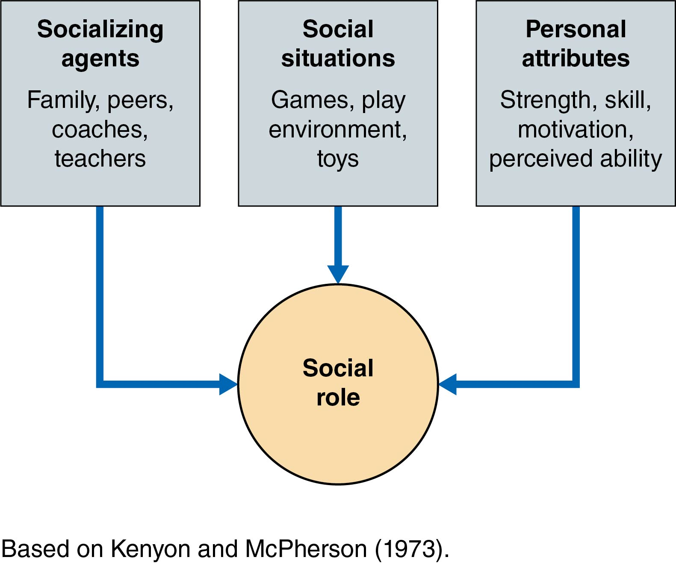
Figure 15.2: Socialization Process

Slide 5
Socialization Process
People and situations influence individuals in their choice of activities throughout their lives.
There are three major elements:
Significant others (influential or important people, called socializing agents)
Social situations (places where socialization takes place: schools, home, playgrounds)
Personal attributes (individual constraints)

Slide 6
Gender Typing: Example of a Sociocultural Constraint
Sex refers to male or female biological characteristics (individual constraint).
Gender refers to socially determined masculine or feminine characteristics (sociocultural constraint).
Why is it important to differentiate between “sex” and “gender” in the context of physical activity?

Slide 7
Gender Typing
Socializing agents, including significant others, often encourage children to participate in “gender-appropriate” activities.
Boys: “masculine” sports (e.g., football, wrestling)
Girls: “feminine” sports (e.g., gymnastics, figure skating)
(continued)

Slide 8
Gender Typing (continued)
Societal attitudes about gender-appropriate activities can restrict physical activity options for boys and girls.
In the United States, these attitudes linger, but the number of girls participating in sports has dramatically increased.
Girls still lag behind boys in number of participants.
Girls are more likely to drop out of sport after high school.

Slide 9
Influence of Title IX
Before Title IX legislation was passed in 1972, 4 million males and fewer than 300,000 females participated in high school sports.
In 2016–2017, 4.5 million males and 3.4 million females participated.
More boys and girls select gender-neutral sports than highly gendered sports.
Constraint to girls’ participation was the sociocultural environment rather than an individual constraint.

Slide 10
Question
What gender stereotypes are associated with the following activities?
Ballet
Baseball
Soccer
Synchronized swimming
Can you think of cases where athletes went against the stereotype? How many?

Slide 11
Significant Others
Influential people who are considered socializing agents
Parents, siblings, peers, teachers, and coaches

Slide 12
Significant Others: Parents
Parents are particularly important during early childhood.
Gender of both child and parent matters.
Fathers tend to reinforce gender typing in boys. (Lewko & Greendorfer, 1988)
Same-sex parent may be more influential. (Snyder & Spreitzer, 1973; Lewko & Ewing, 1980)
Attitudes of parents are changing, especially as more mothers were sport participants.

Slide 13
Significant Others: Siblings
Siblings constitute a child’s first playgroup.
Girls’ sport participation is influenced by brothers (Weiss & Knoppers, 1982) and sisters (Lewko & Ewing, 1980).
As a person leaves childhood, sibling influence tends to diminish.
Patterns of family influence vary by social background, race, and geographic location.

Slide 14
Significant Others: Peers
Peer groups are particularly important after childhood.
Peers provide a strong influence for group activities, including team sports and nonsport clubs.
Peer group preference for passive activities can lead once-active children into sedentary adolescence.

Slide 15
Significant Others: Coaches and Teachers
Research is inconclusive regarding their role in socialization into physical activity.
Research suggests they act primarily to reinforce existing socialization patterns.
Teachers and coaches must avoid providing aversive socialization (Snyder & Spreitzer, 1973), which discourages participation.

Slide 16
Question
How can a significant other act as a constraint to motor development? Provide a positive and a negative example.

Slide 17
Assessing Youth Sport Coaching Behaviors
Coaching Self-Report Form
Helps coaches note the frequency of desired behaviors in a practice or game
Enhances possibility of being a positive socializing agent for youths

Slide 18
Social Situations
Play environments and games can act as constraints.
Lack of adequate space can diminish opportunities for gross motor activity.
Gender-typed play environments, games, and toys can deprive girls of opportunities to perform complex, difficult skills.
(continued)

Slide 19
Social Situations (continued)
Play with toys can act as constraints.
May encourage children to be active or inactive
Gender typing via toys
Toys marketed to boys tend to be more complex and encourage more vigorous activity than those marketed to girls.
Toys can encourage traditional gender roles.
Marketing, advertising, and packaging of toys can lead to gender typing.
(continued)

Slide 20
Social Situations (continued)
Gender typing via toys (continued)
Parents enjoy giving their children the same kinds of toys they played with as children.
Parents can promote gender typing by negatively reinforcing play with toys they judge to be gender inappropriate.
Video, computer, or streamed games are increasingly influential.

Slide 21
Other Sociocultural Constraints: Race, Ethnicity, and Socioeconomic Status
It is often difficult to distinguish between sociocultural constraints and individual constraints.
Racial characteristics are biological based and relate to genetic similarities within groups.
Ethnic characteristics are culturally based and relate to cultural similarities that connect groups.
(continued)

Slide 22
Other Sociocultural Constraints: Race, Ethnicity, and Socioeconomic Status (continued)
Socioeconomic characteristics can sometimes be interrelated to racial and ethnic characteristics.
It is important to examine differences among groups without suggesting a priority that differences are biological in nature.
Stereotyped threat of a stigmatized group can result in pressure to perform below one’s actual capabilities.

Slide 23
Summary and Synthesis
As individuals, we constantly interact with and depend on others as a part of daily life.
Youth are socialized into sport.
People are often associated with many different groups, ranging in size from small to large.
Sociocultural constraints continually interact with functional individual constraints that encourage and discourage movements through participation in activities.

