Slide 1
YOUTH SPORTS

Slide 2
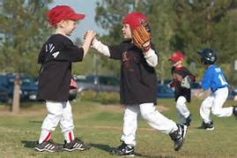
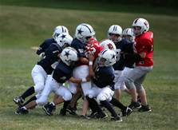
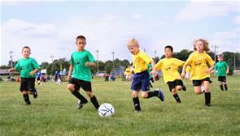
2010 Participation
Youth Soccer 650,000
Pop Warner 240,000 + 120,000 Cheerleaders
High School – 4.5 million boys, 3 million girls
70 million parents, 3.5 million coaches
35 million children 3-14 yrs. old in youth sports
~ 40 million combined youth & H.S. sports

Slide 3
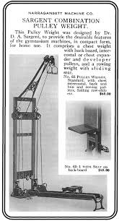
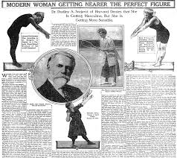
Horace Mann - 1838
Dudley Sargent

Slide 4
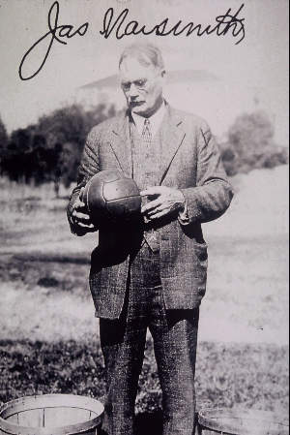
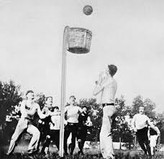
James Naismith

Slide 5
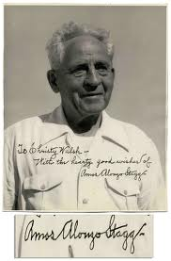
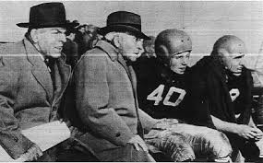
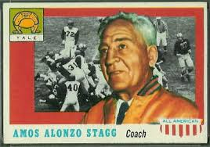
Amos Alonzo Stagg -

Slide 6
National Federation of state high school associations

Slide 7
New Jersey State Interscholastic Athletic Association

Slide 8
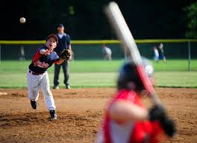
Little League

